Slide 1

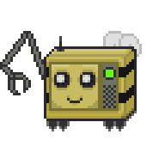
Space Station 13:
Transitioning to Open Source
Kai Richardson
Maintainer for Goonstation
Notes:
Hi everyone!
I’m Kai Richardson, a Maintainer for Goonstation, a flavor of Space Station 13.
I guess, has anyone here actually heard of it?
I’m presenting on Windows and Google Slides - so let’s dive in..

Slide 2

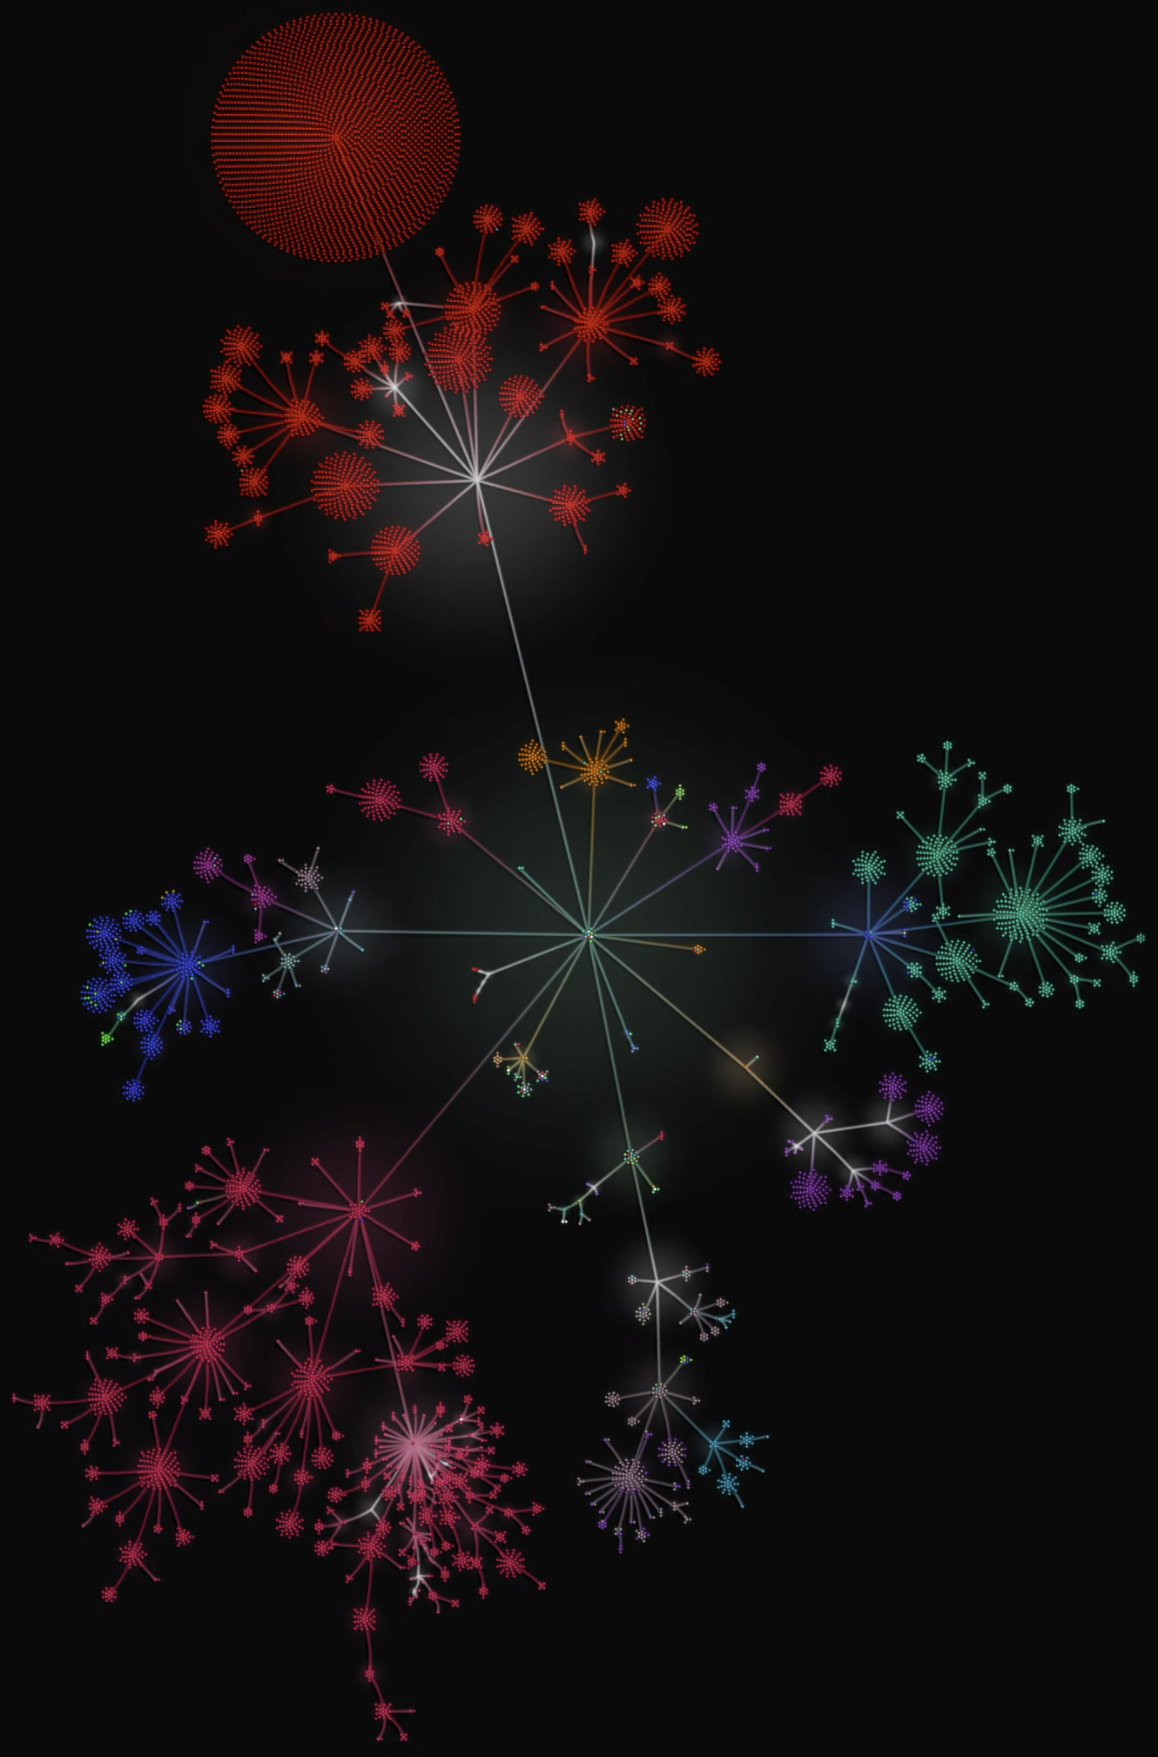
Goonstation?
Game Community
~120 players online
Open-Source* for 3 Years
  59,000* commits
  330+ contributors
  Merge 10-20 contributions / day
Notes:
So, what is Goonstation?
I would broadly describe ourselves as a game development community supporting 4ish game servers, with around 120 players online on average.
Our specific flavor of the game has been open-source for three years.
We have around 59 thousand commits, have over 330 contributors, and merge around 10-20 community contributions per day.
There’s a few asterisks - which I’ll get to in a minute. That’s a picture of our codebase on the right.

Slide 3
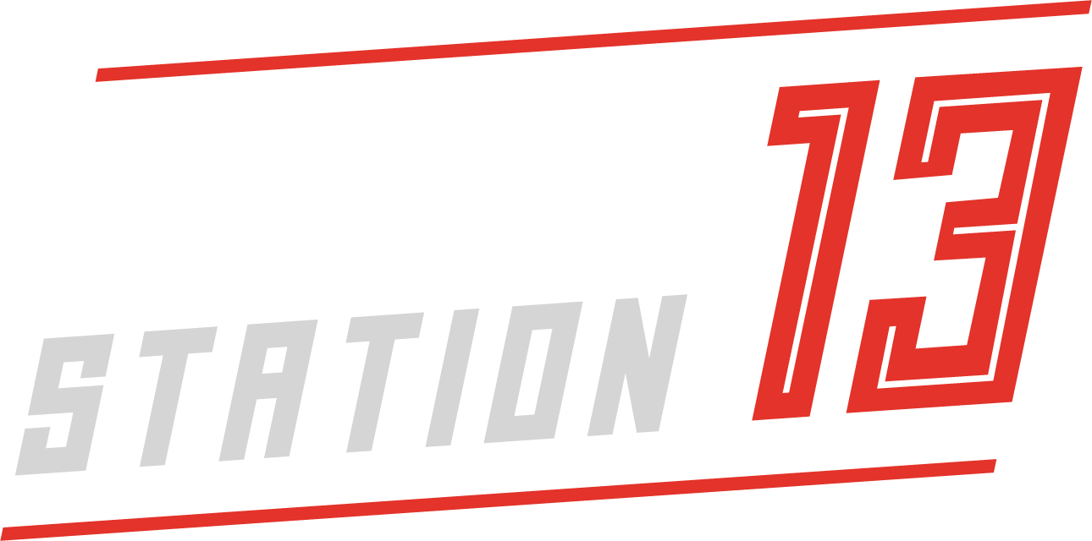

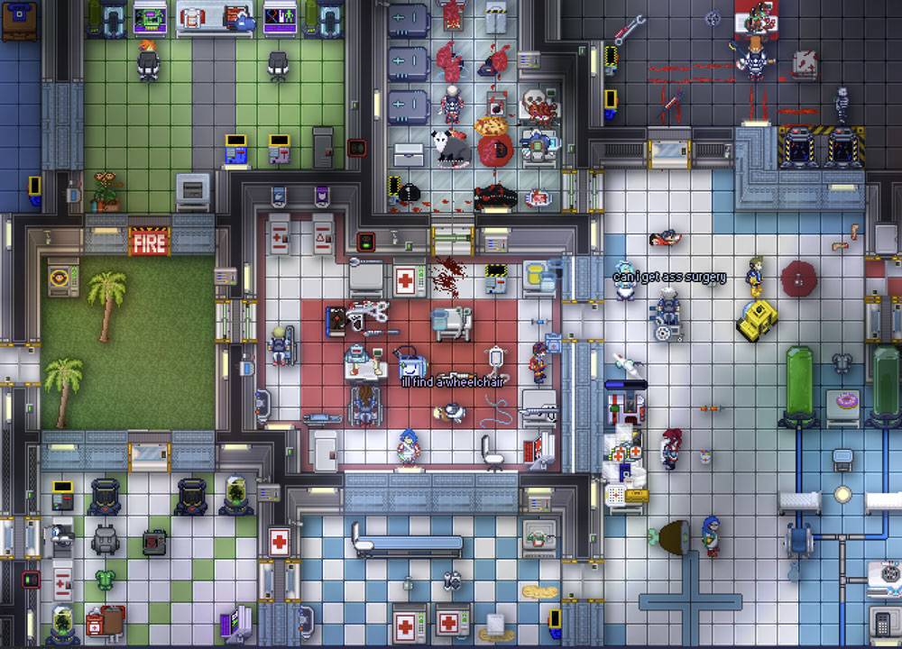
SS13?
Multiplayer Role-Playing Game
Started in 2003
  …more like 2009
Revision 4407
Notes:
Space Station 13 as a whole can be broadly described as a top-down multiplayer round-based role playing game, set on a space station.
The game originally started development in 2003.
However, not much really changed with the game until 2009, when the source was first made available,
mainly in the form of revision 4407 of our codebase.

Slide 4
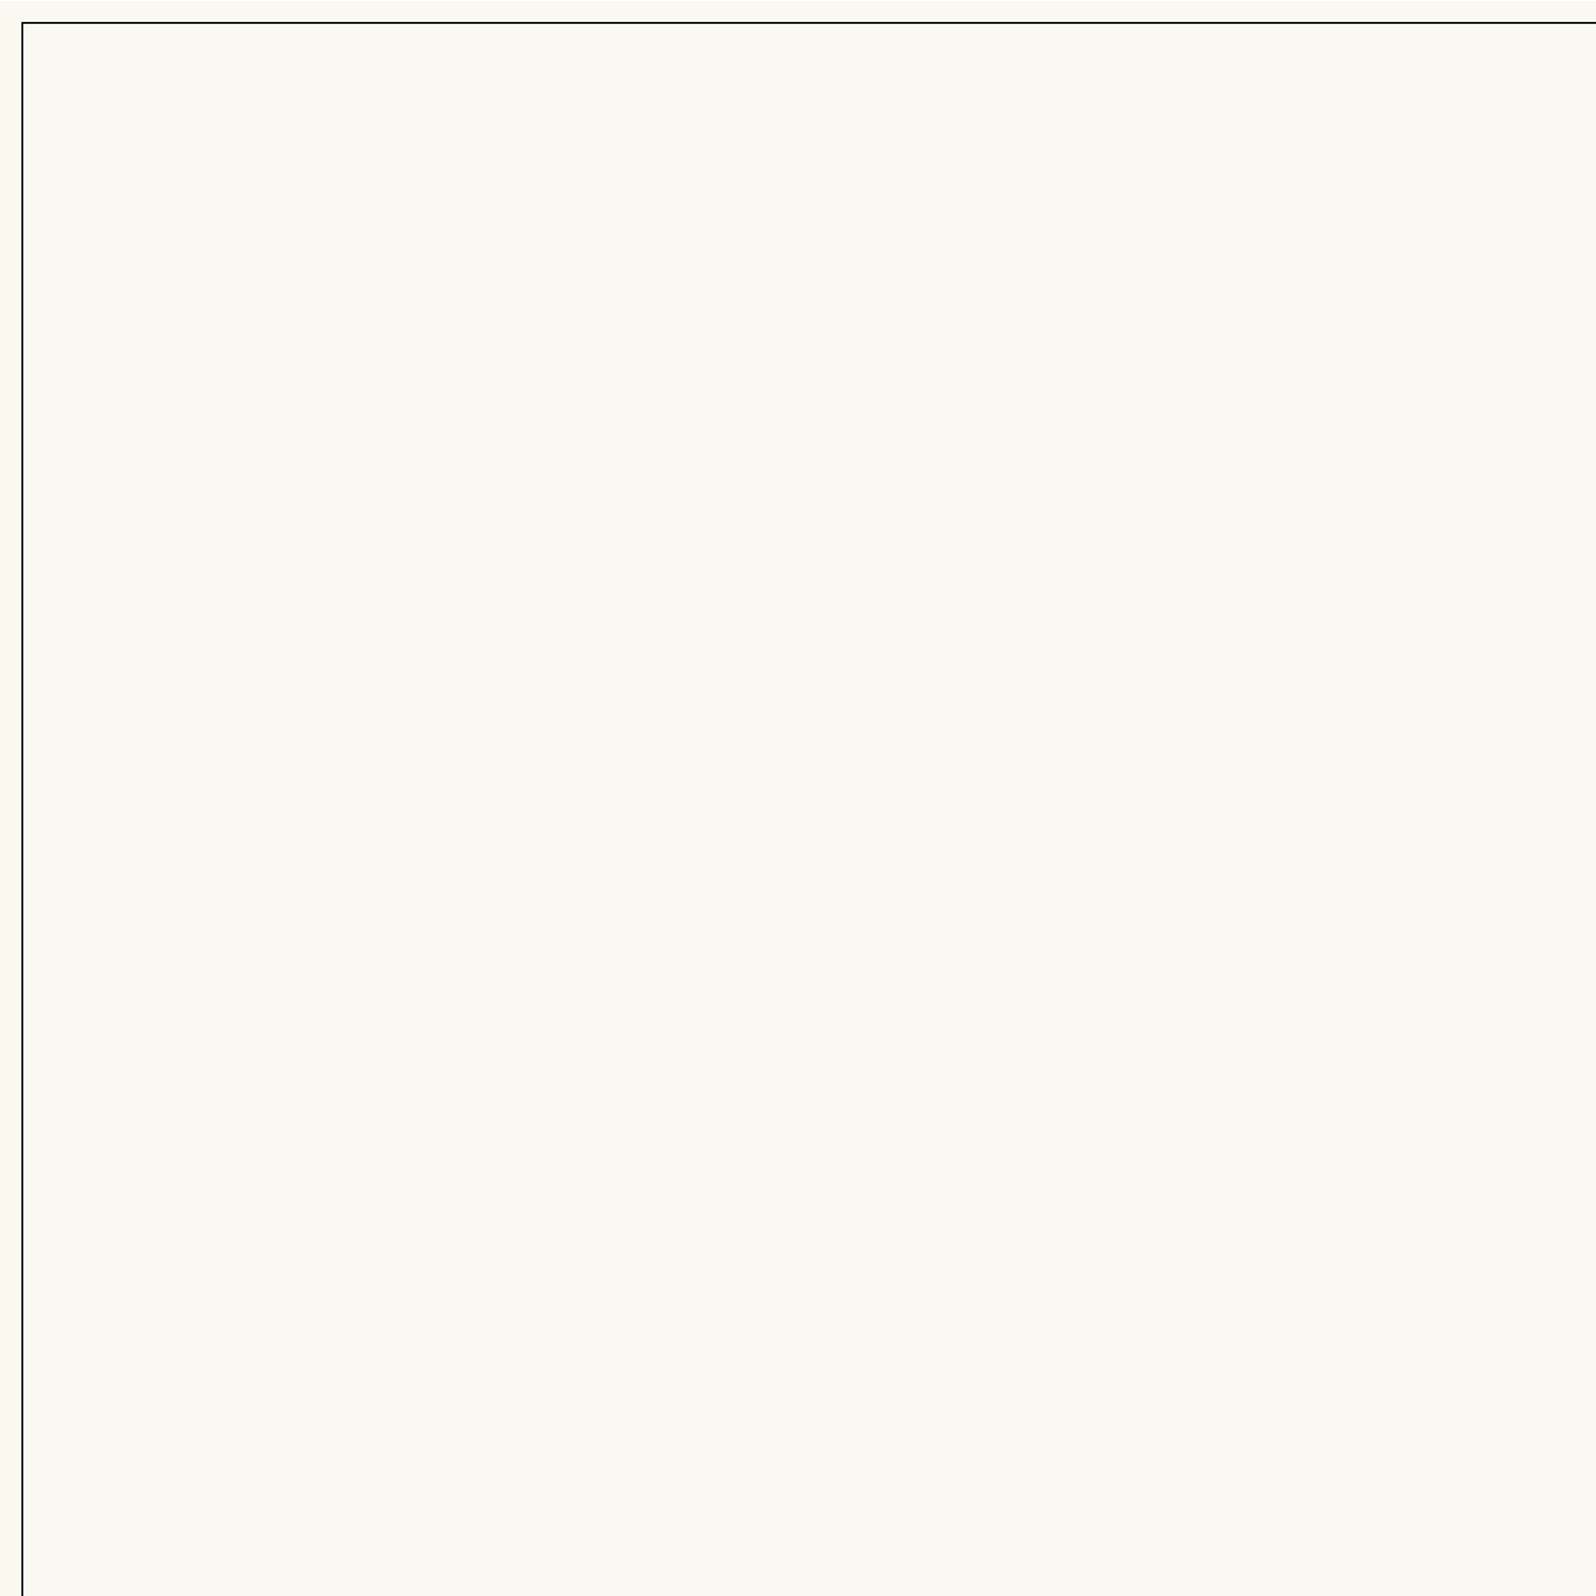
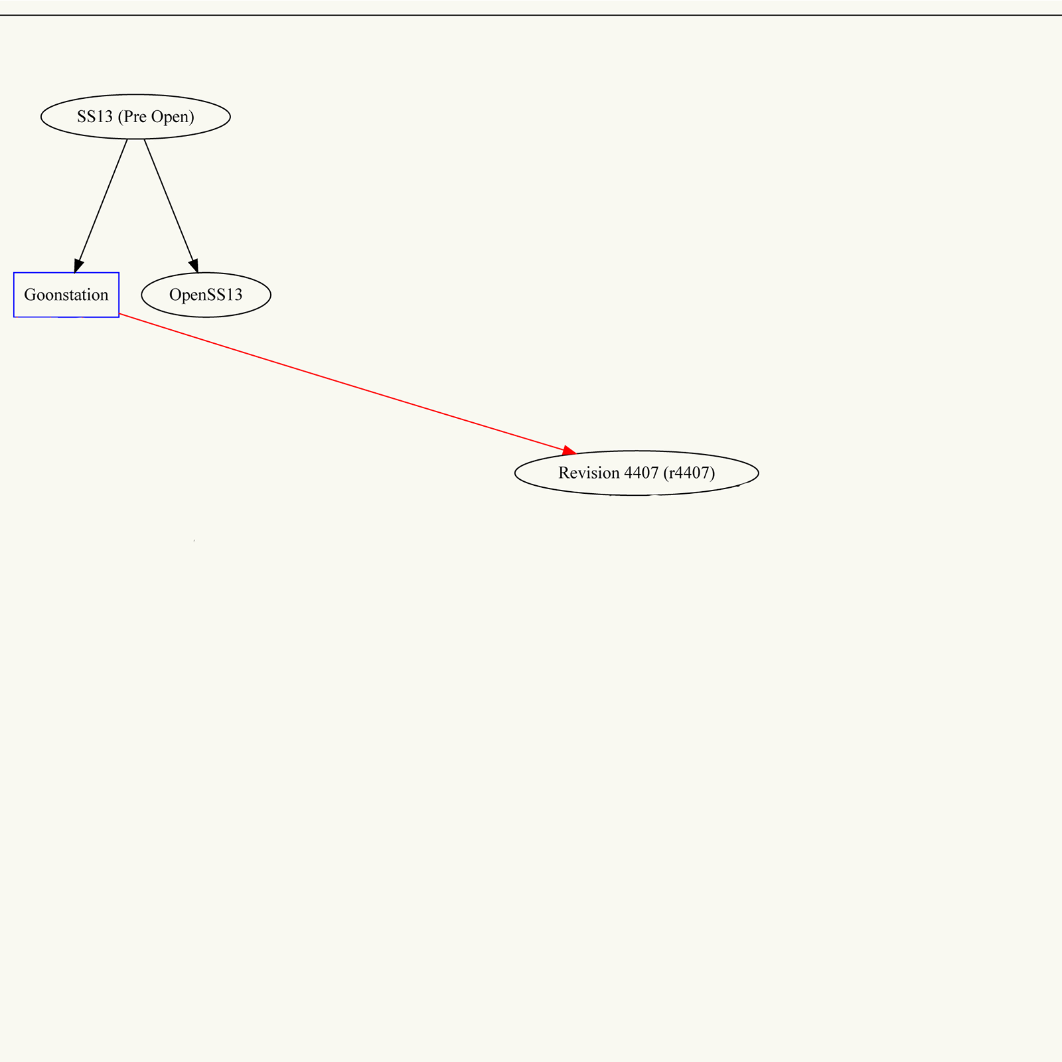
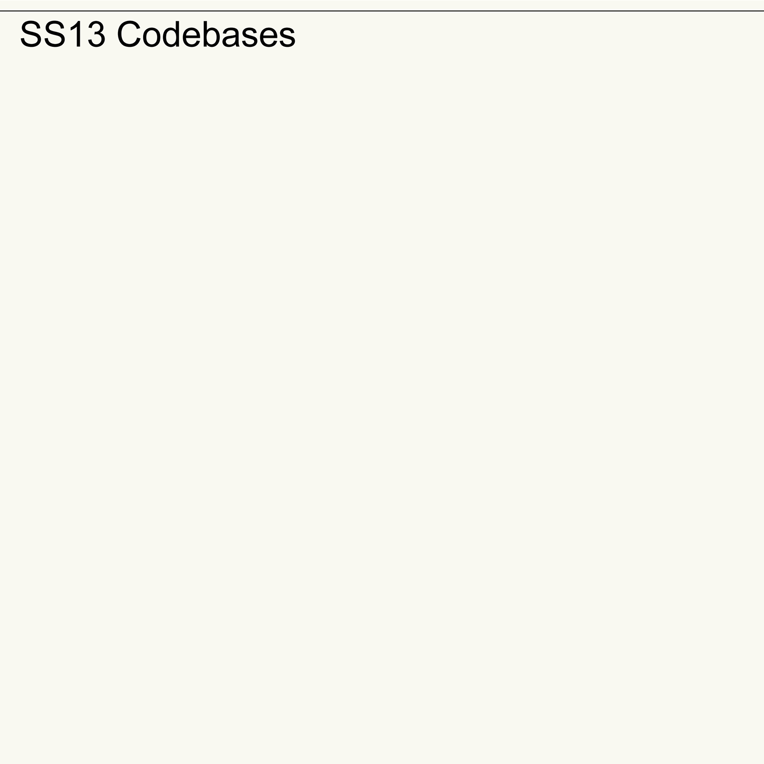
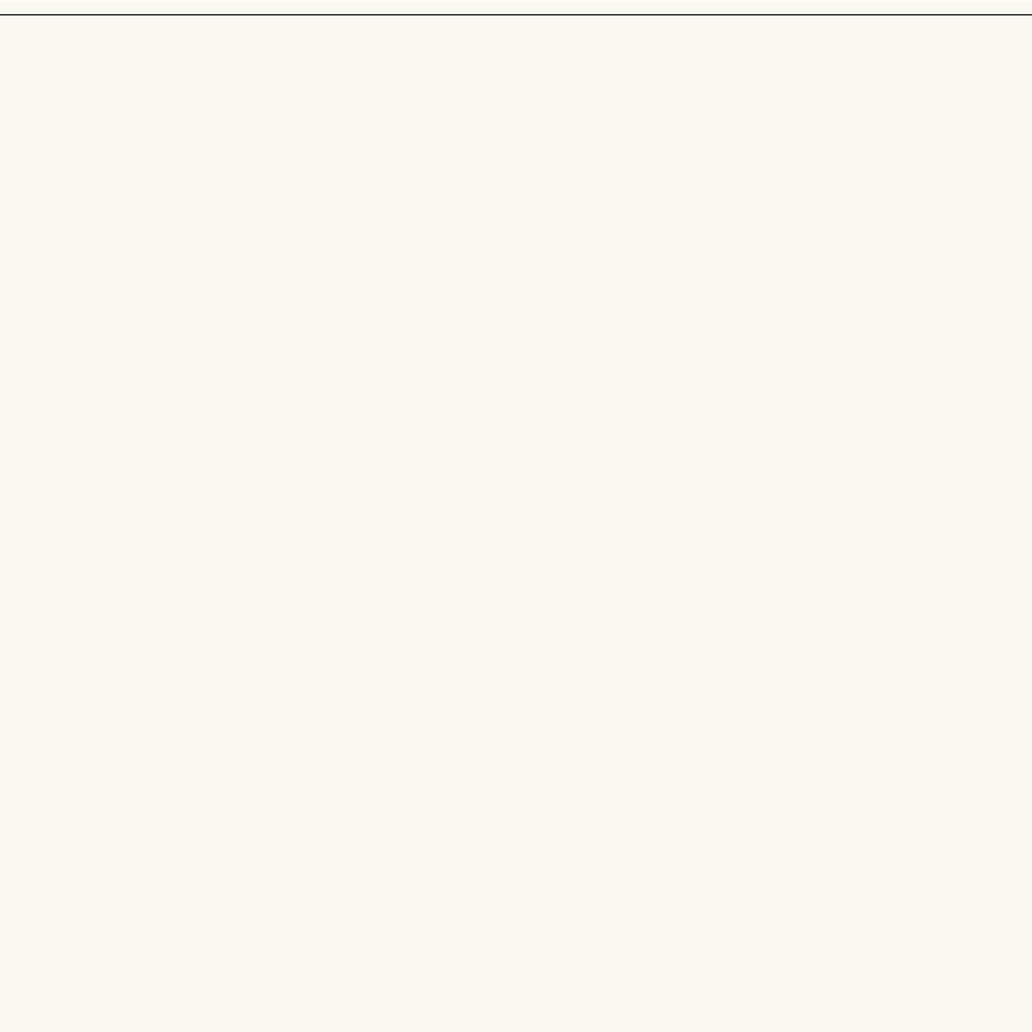
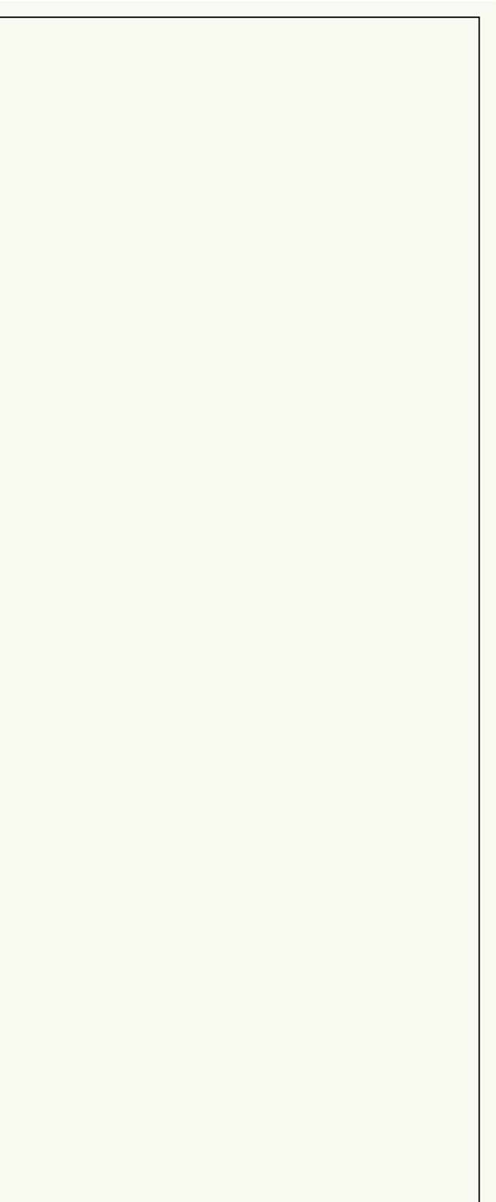
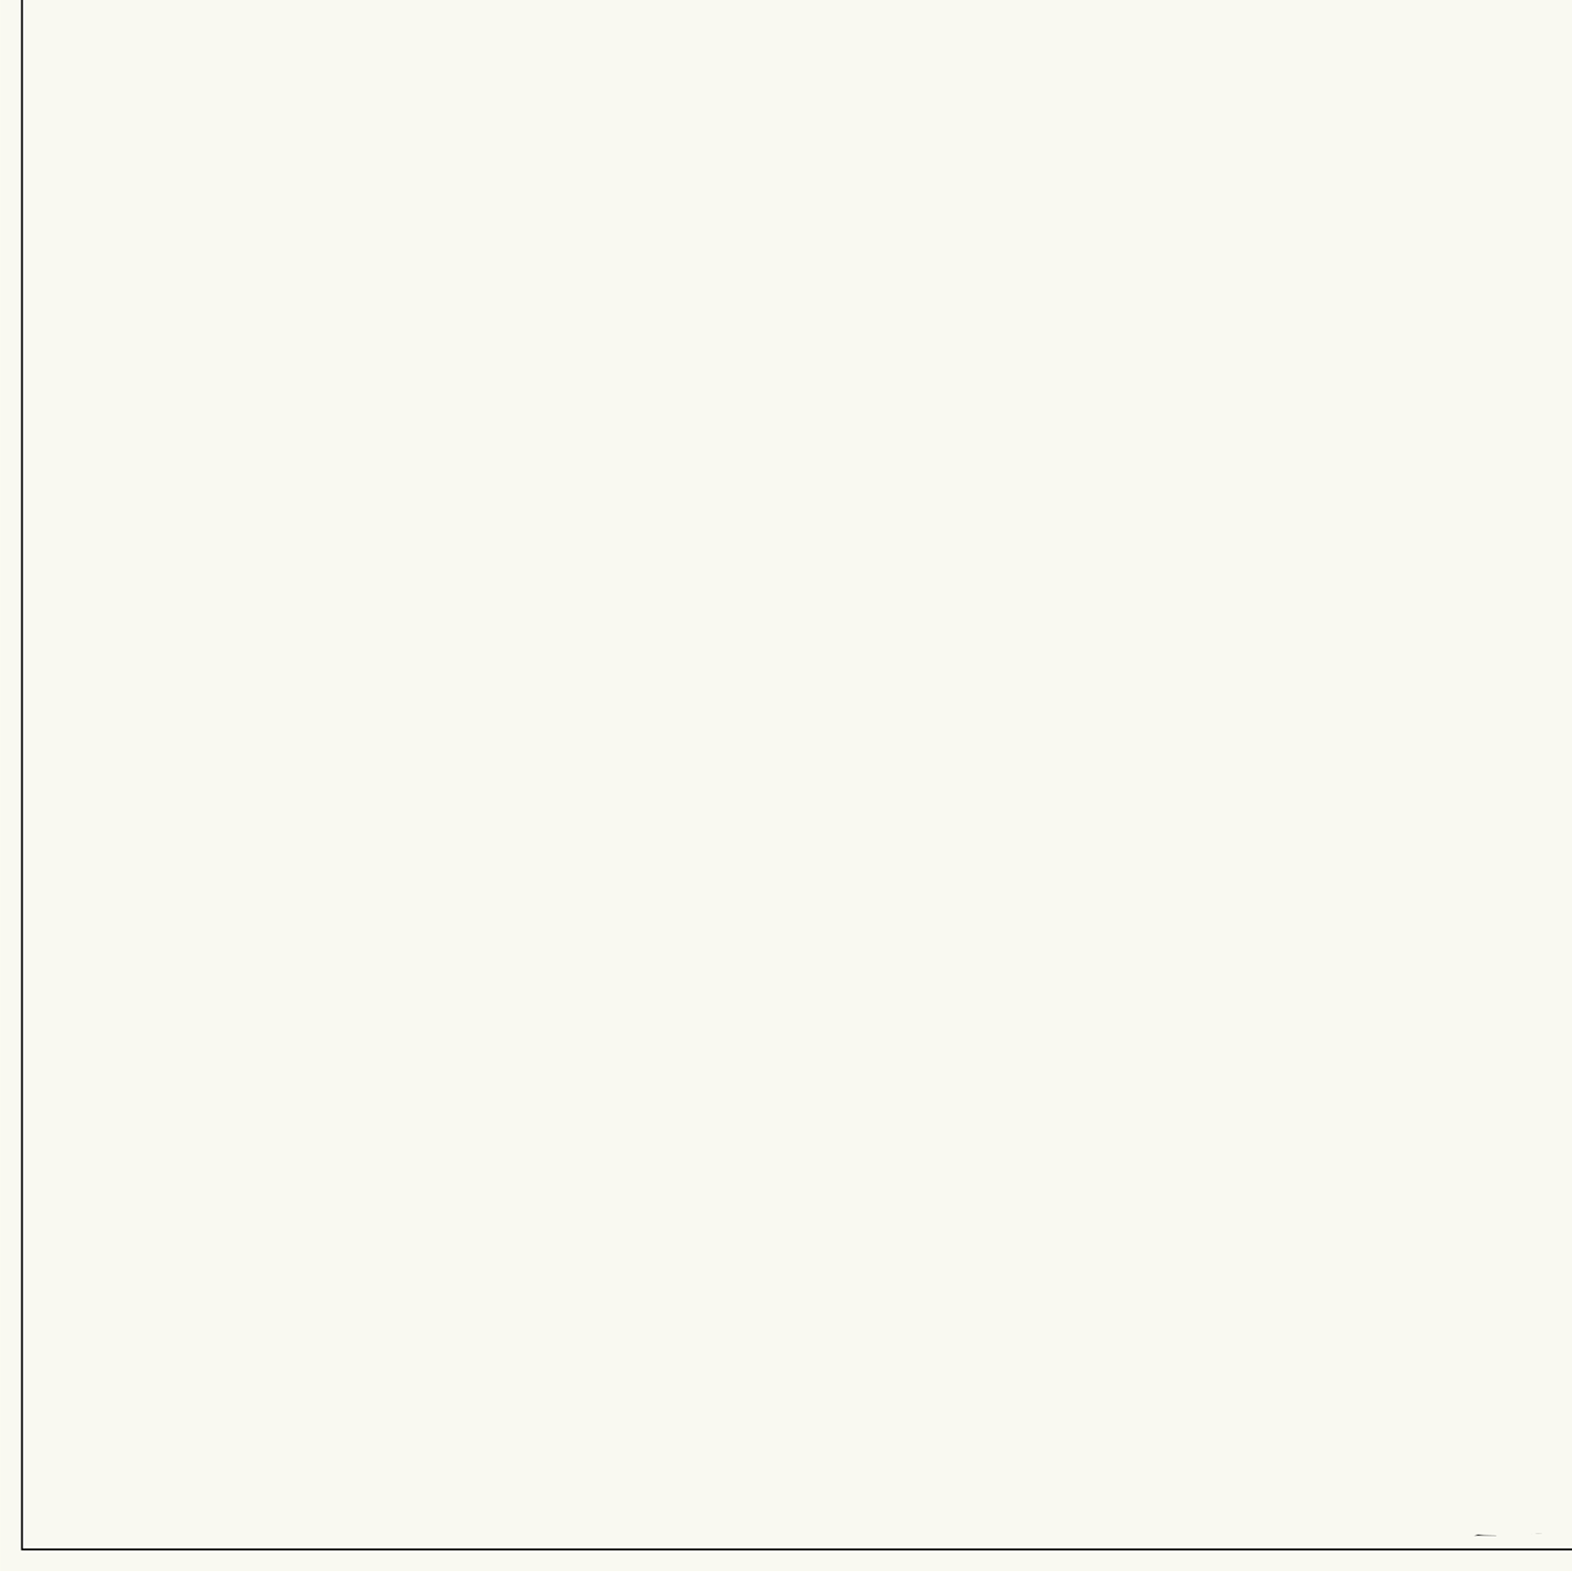
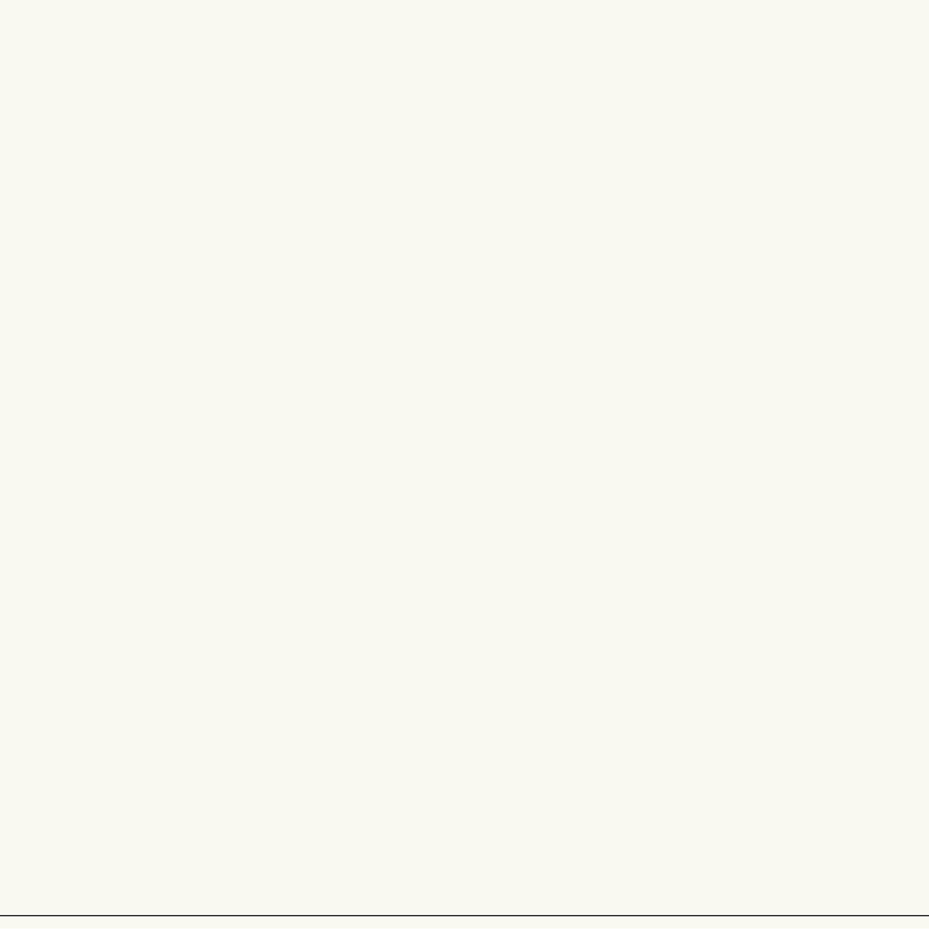
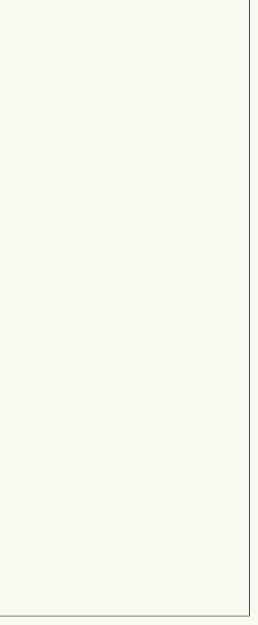
Prehistoric SS13
Notes:
So, here’s how it looked in 2009 with revision 4407 - the reason for the name is that we still used SVN back then.

Slide 5
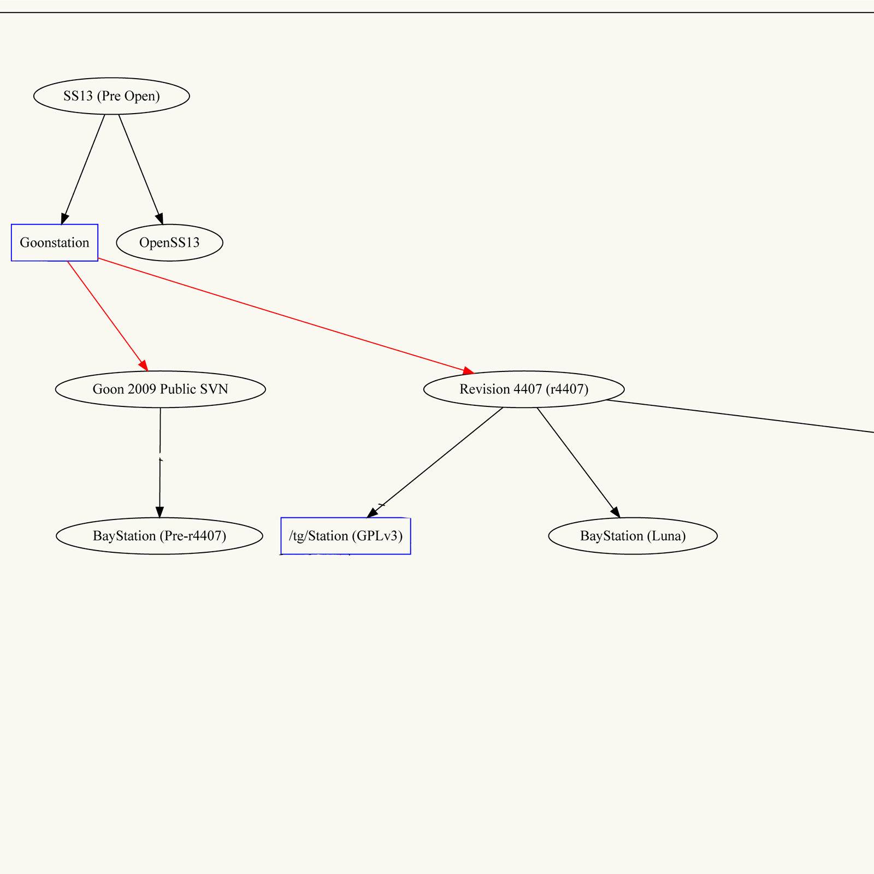
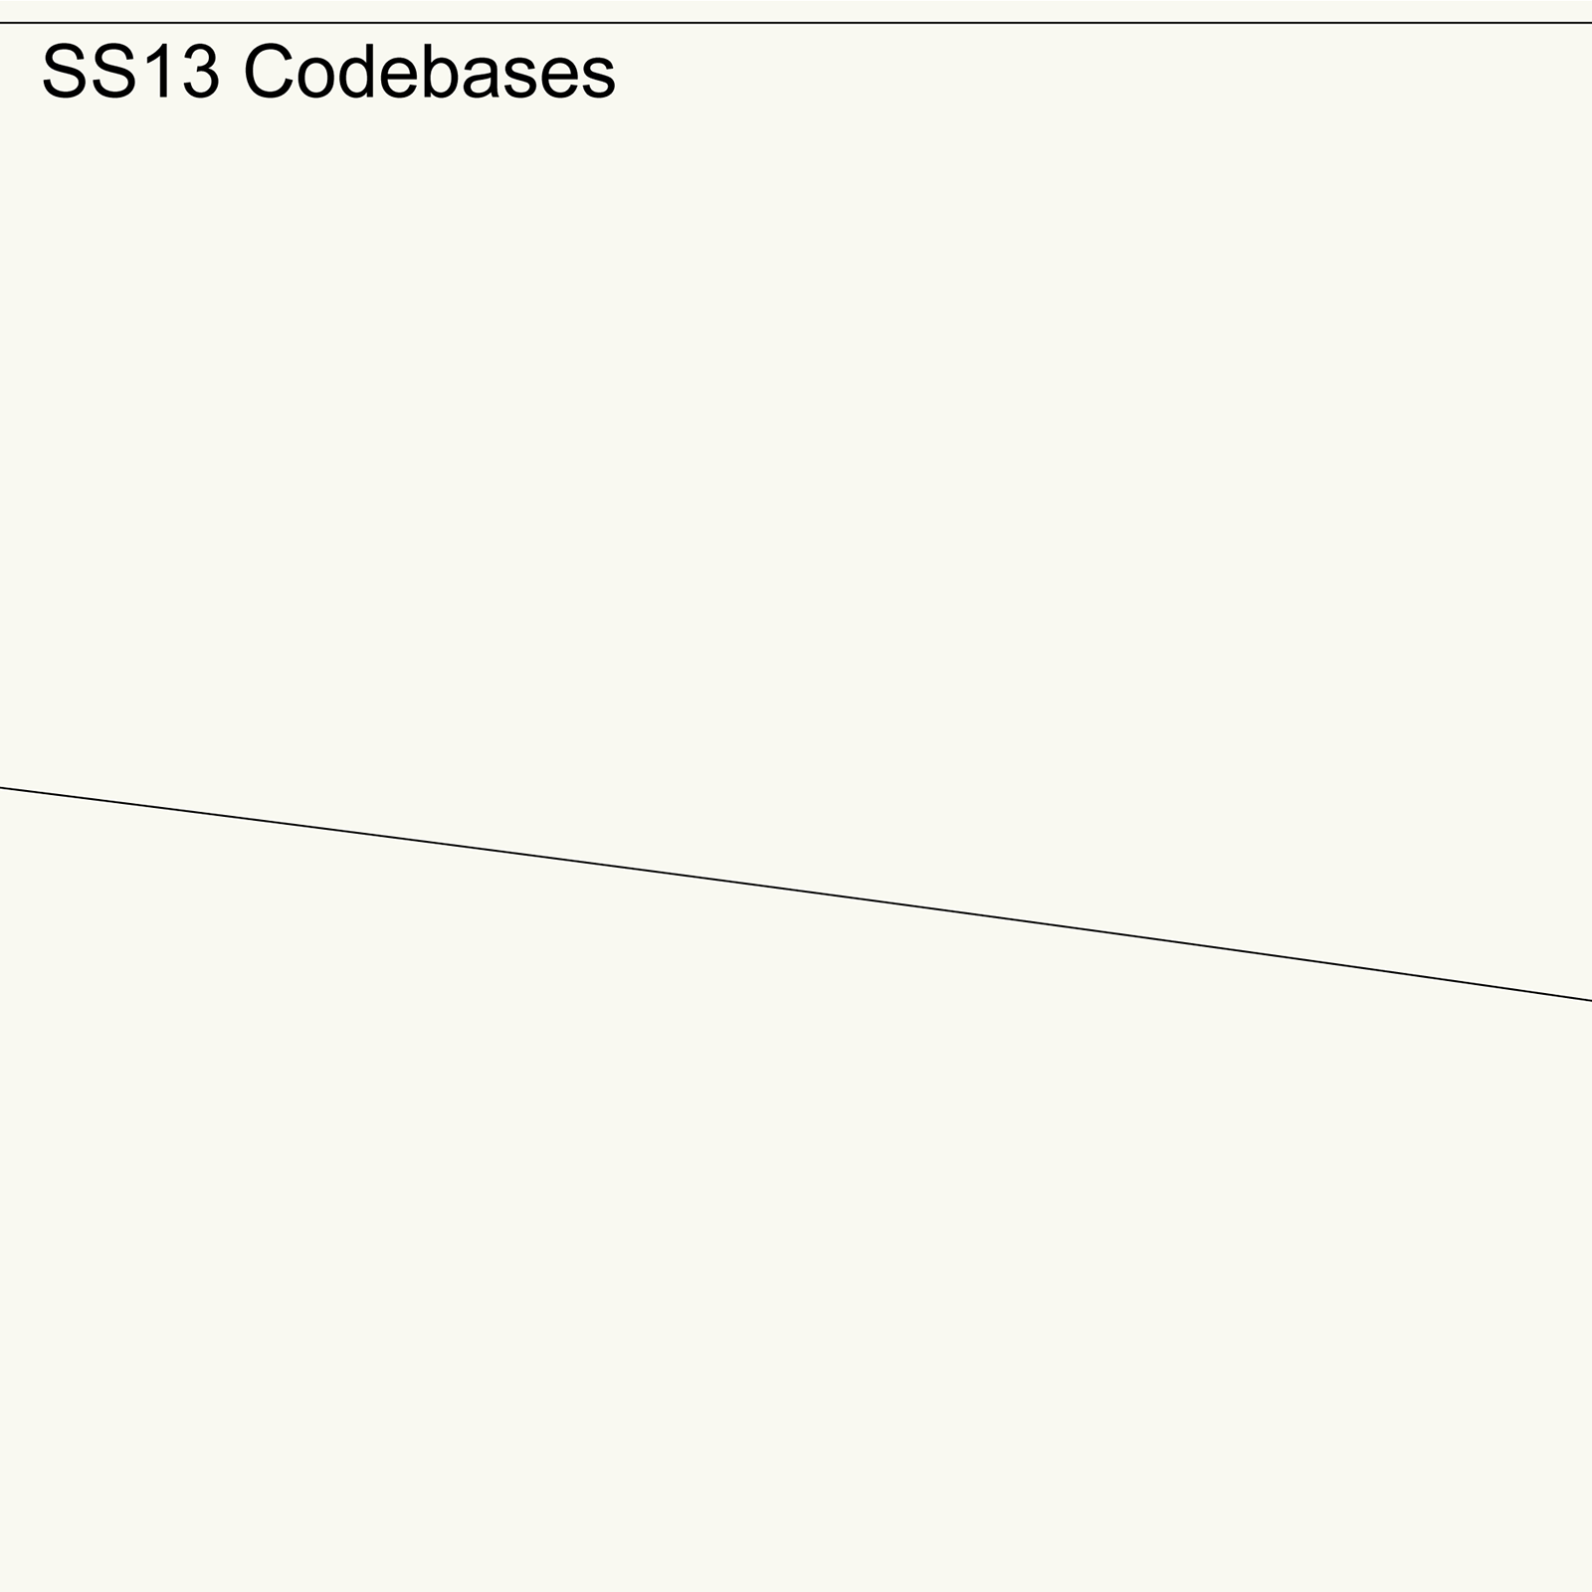
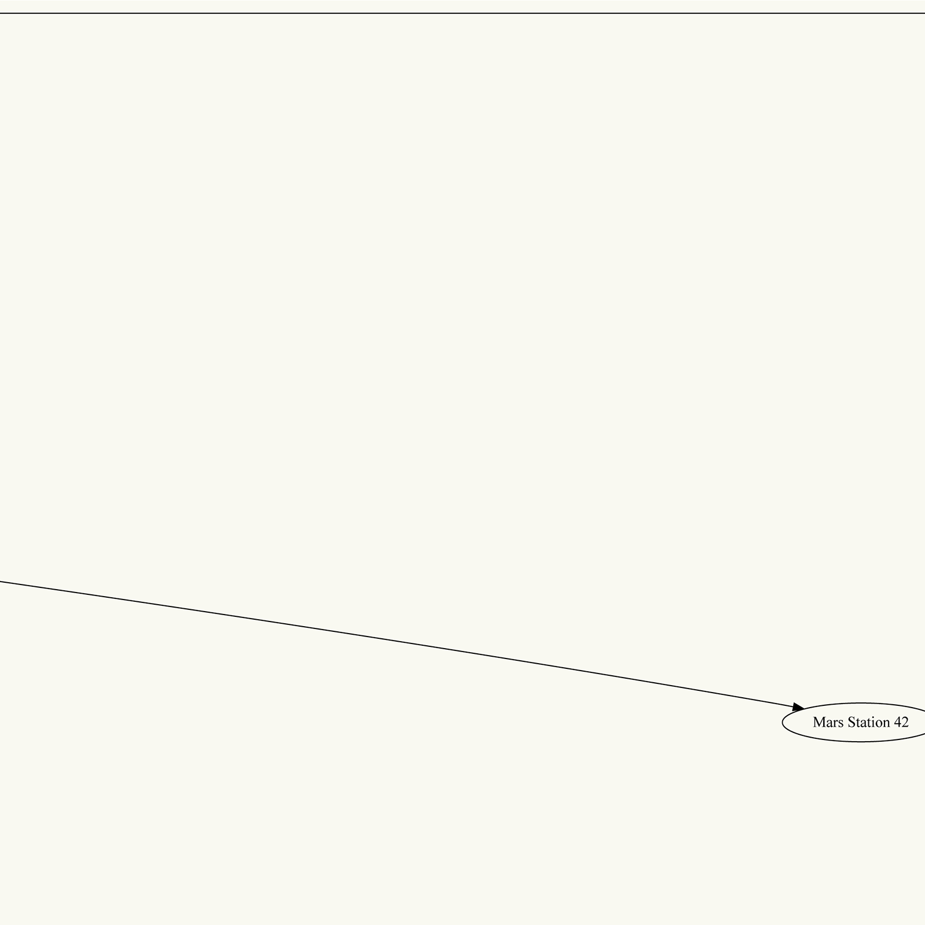
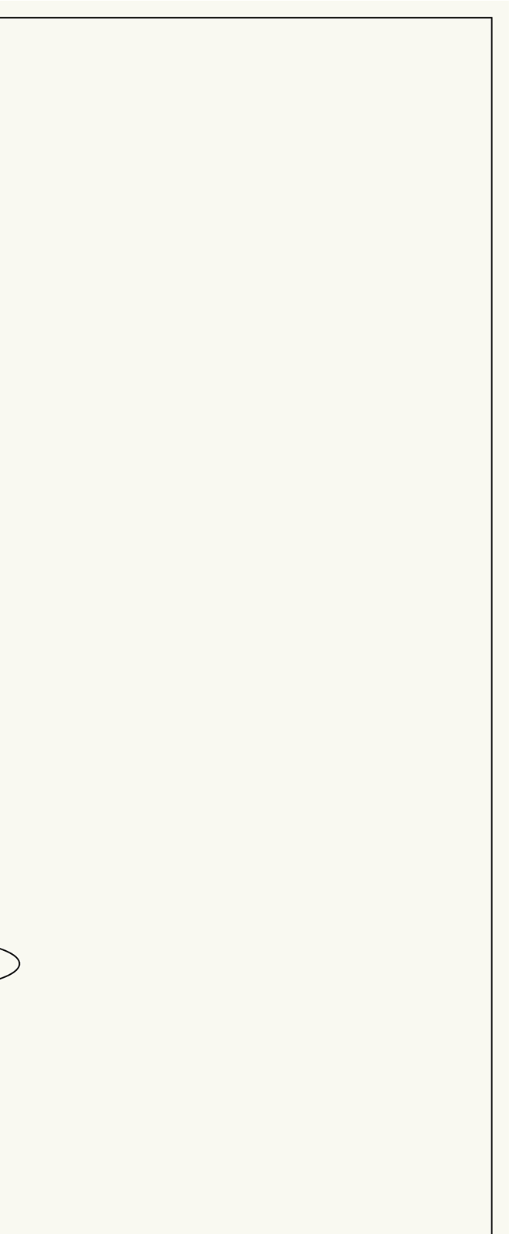
Forks…
Notes:
Here [*point to /tg/], the larger open-source contributing community forked off.

Slide 6
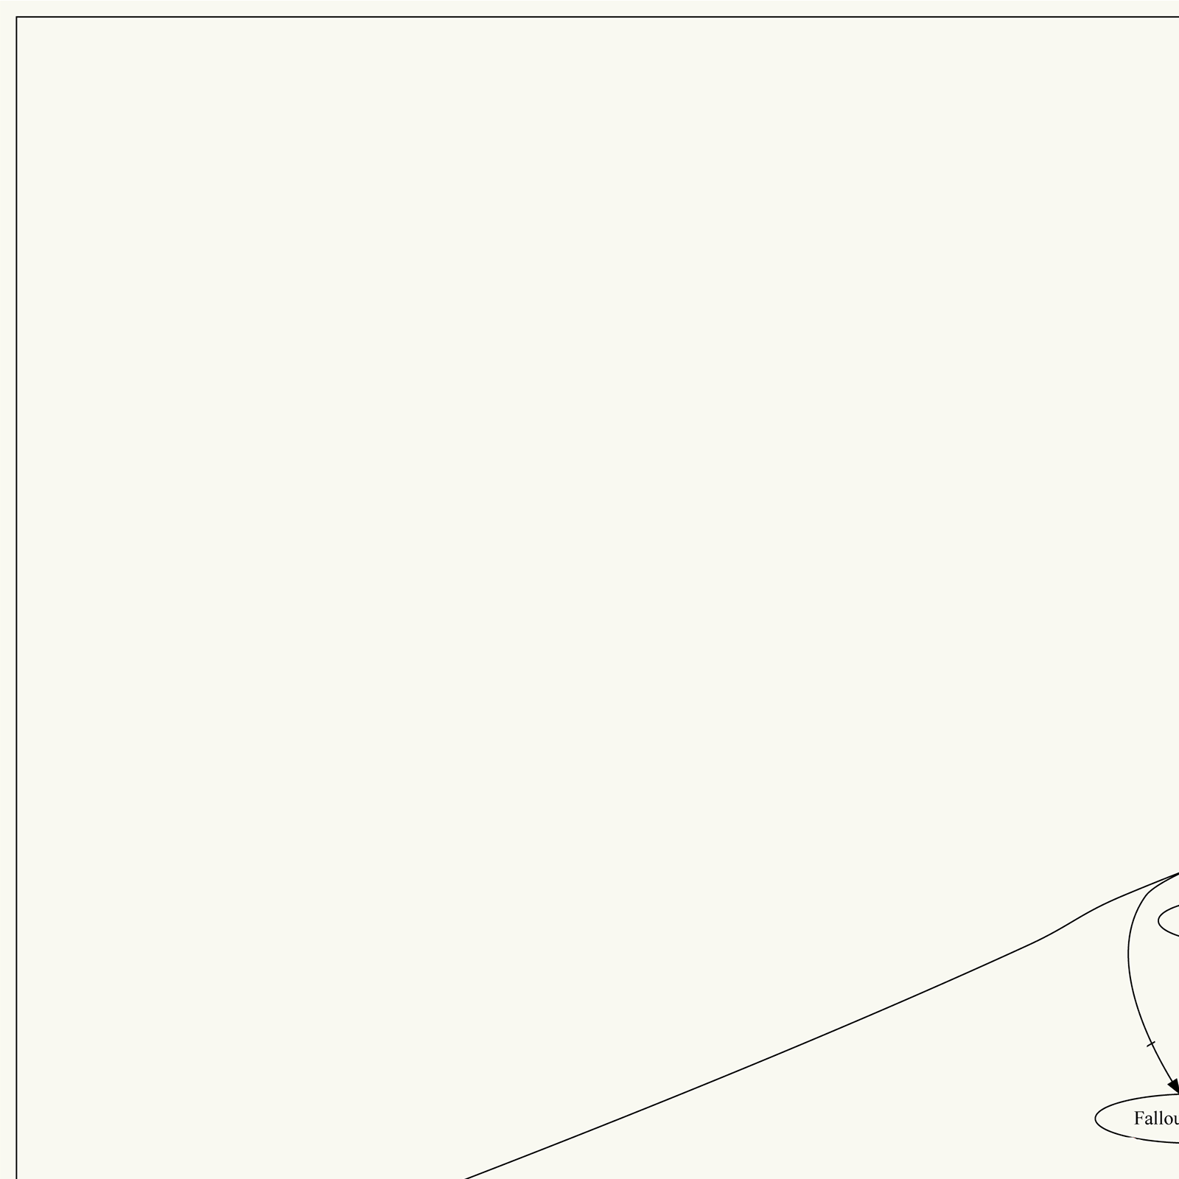
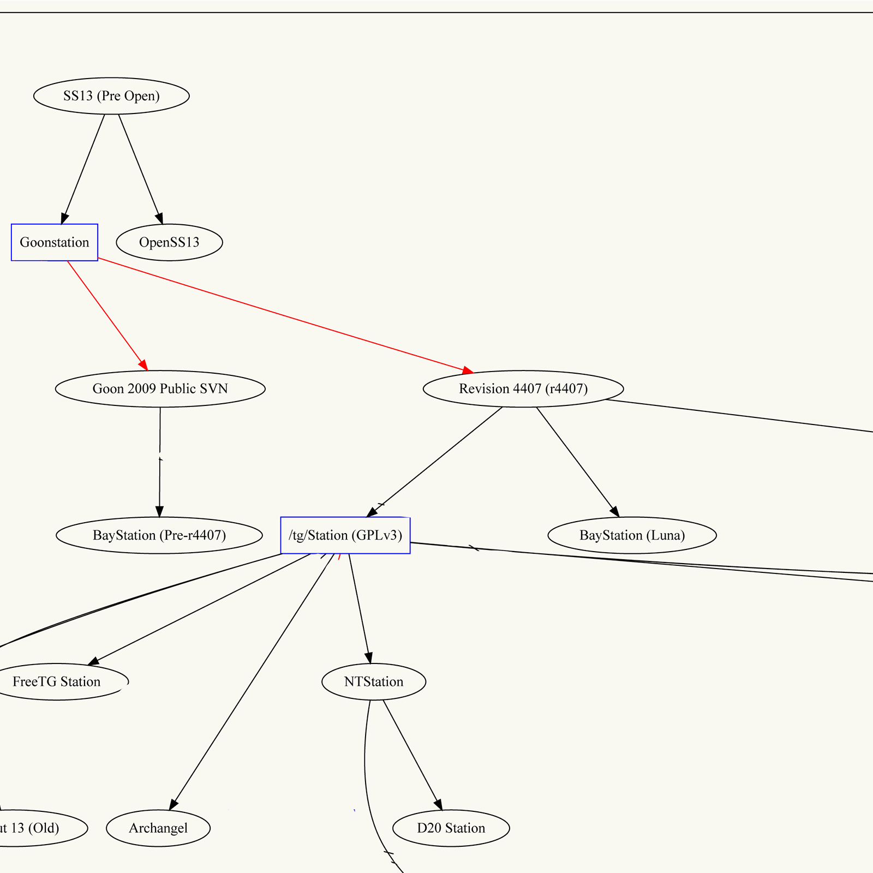

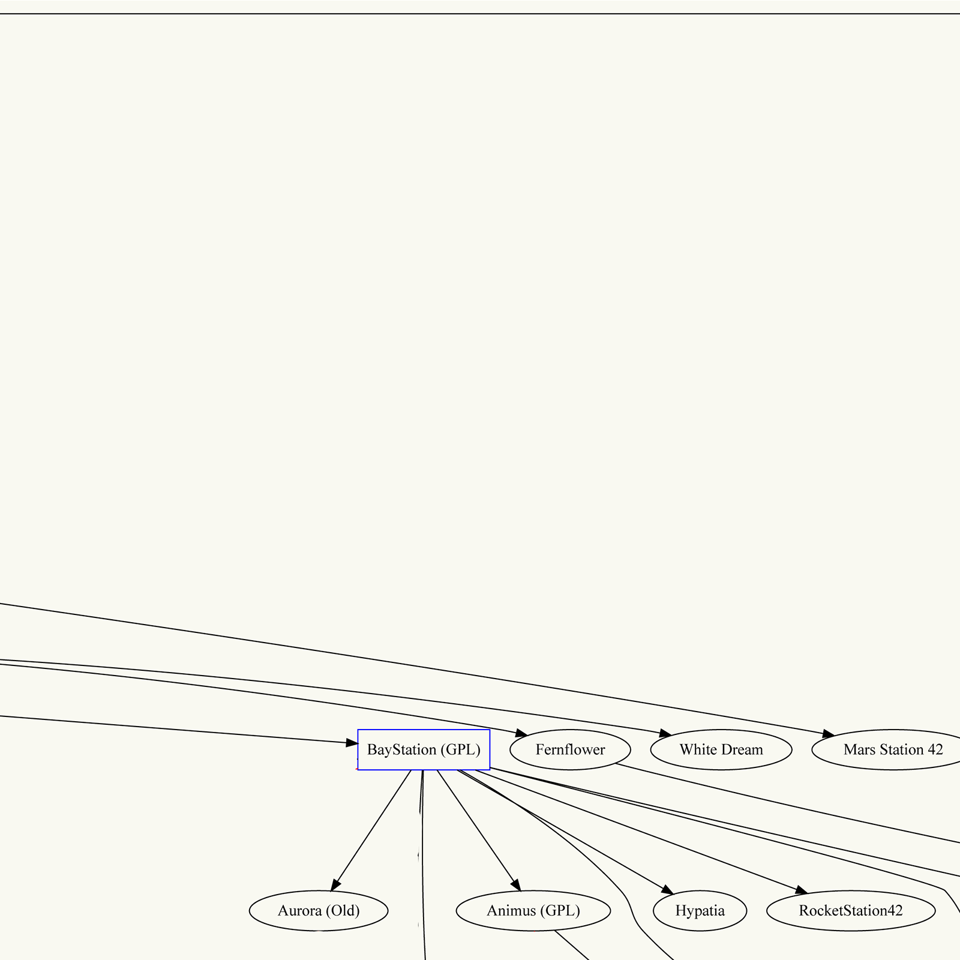
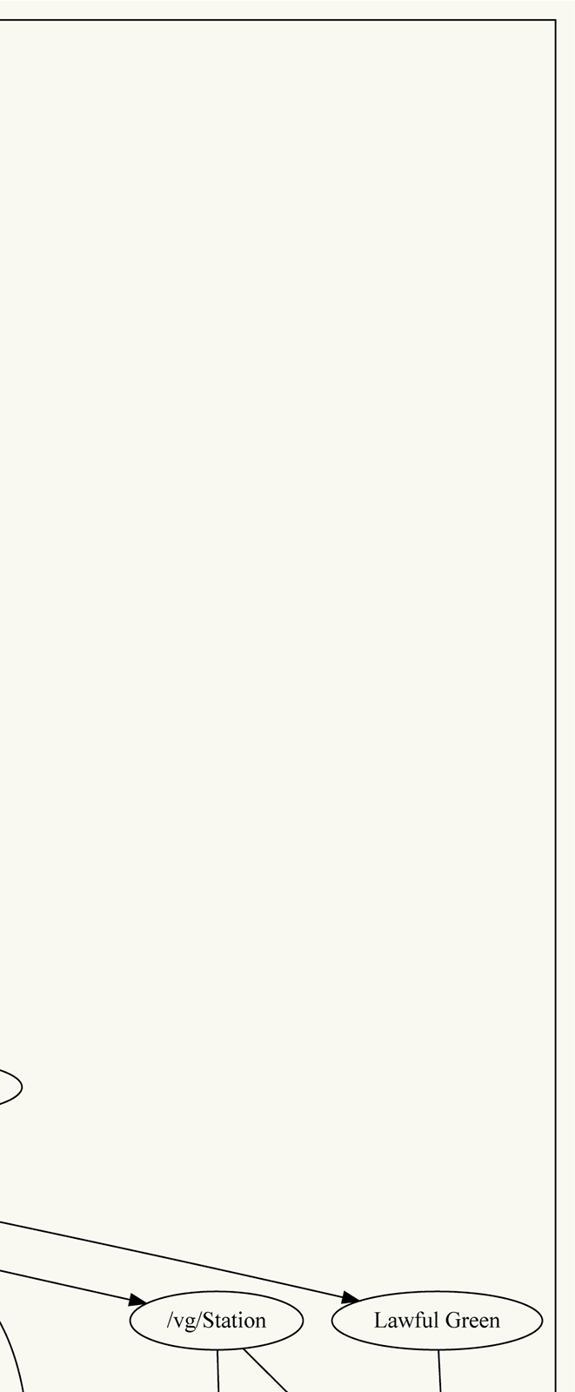
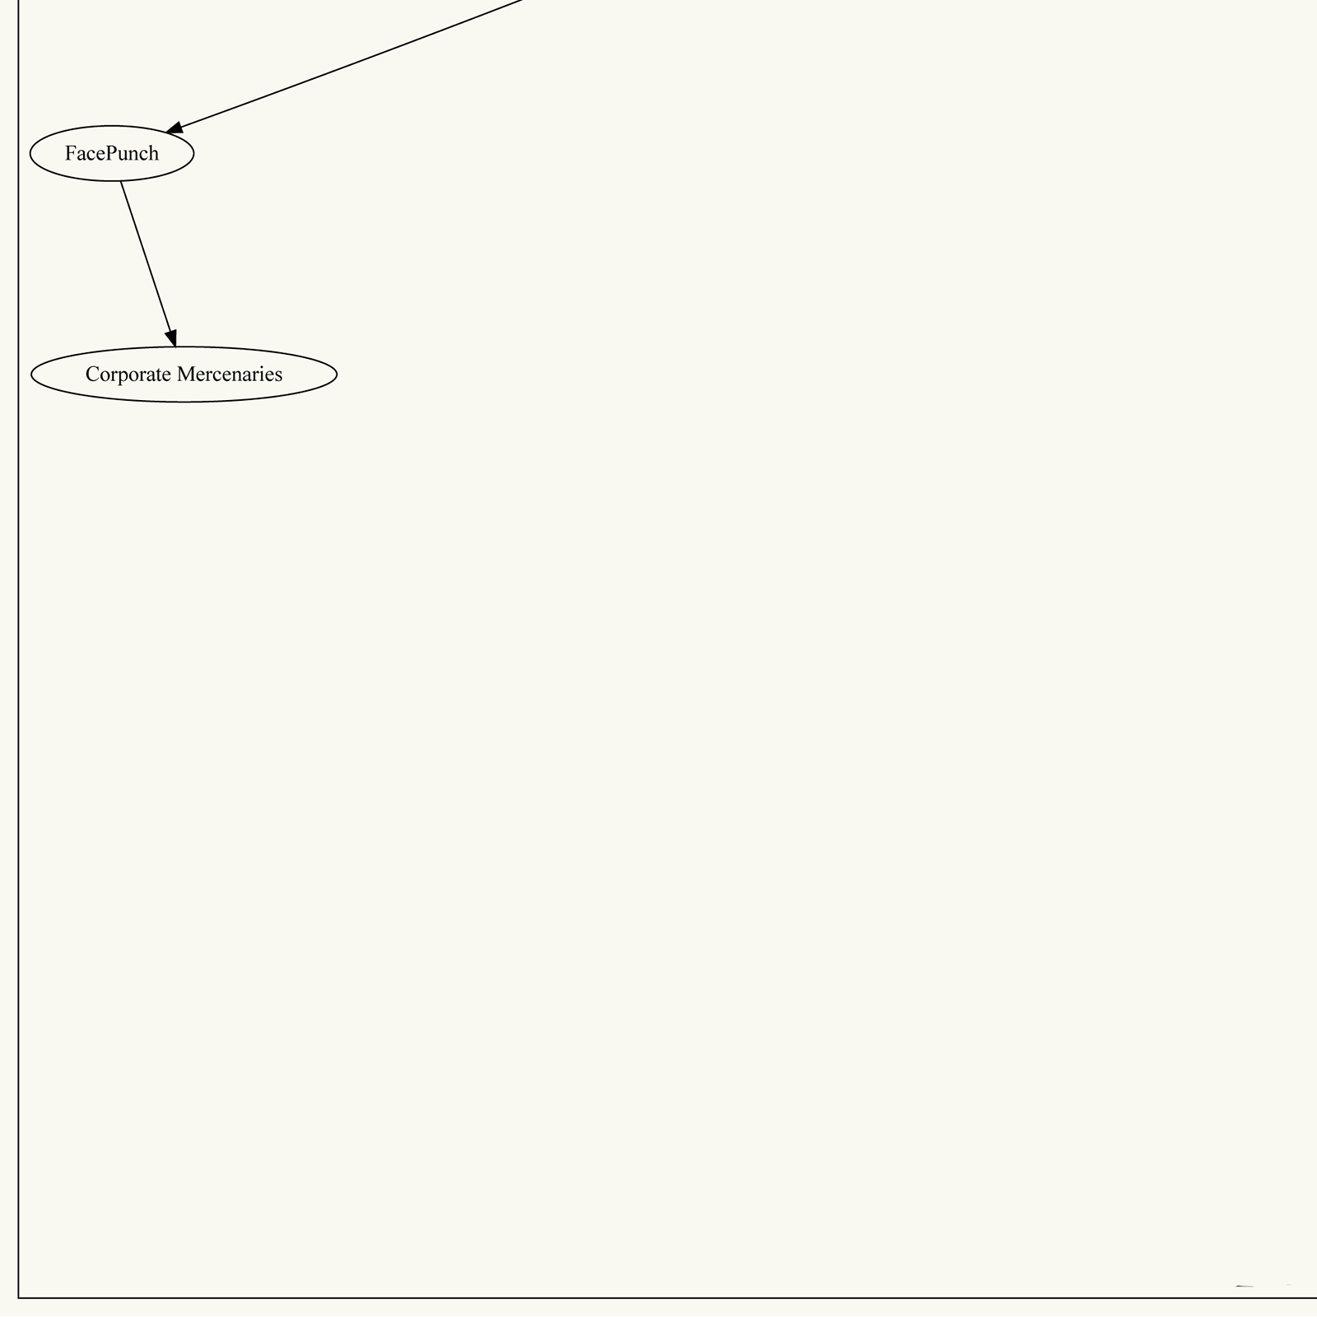
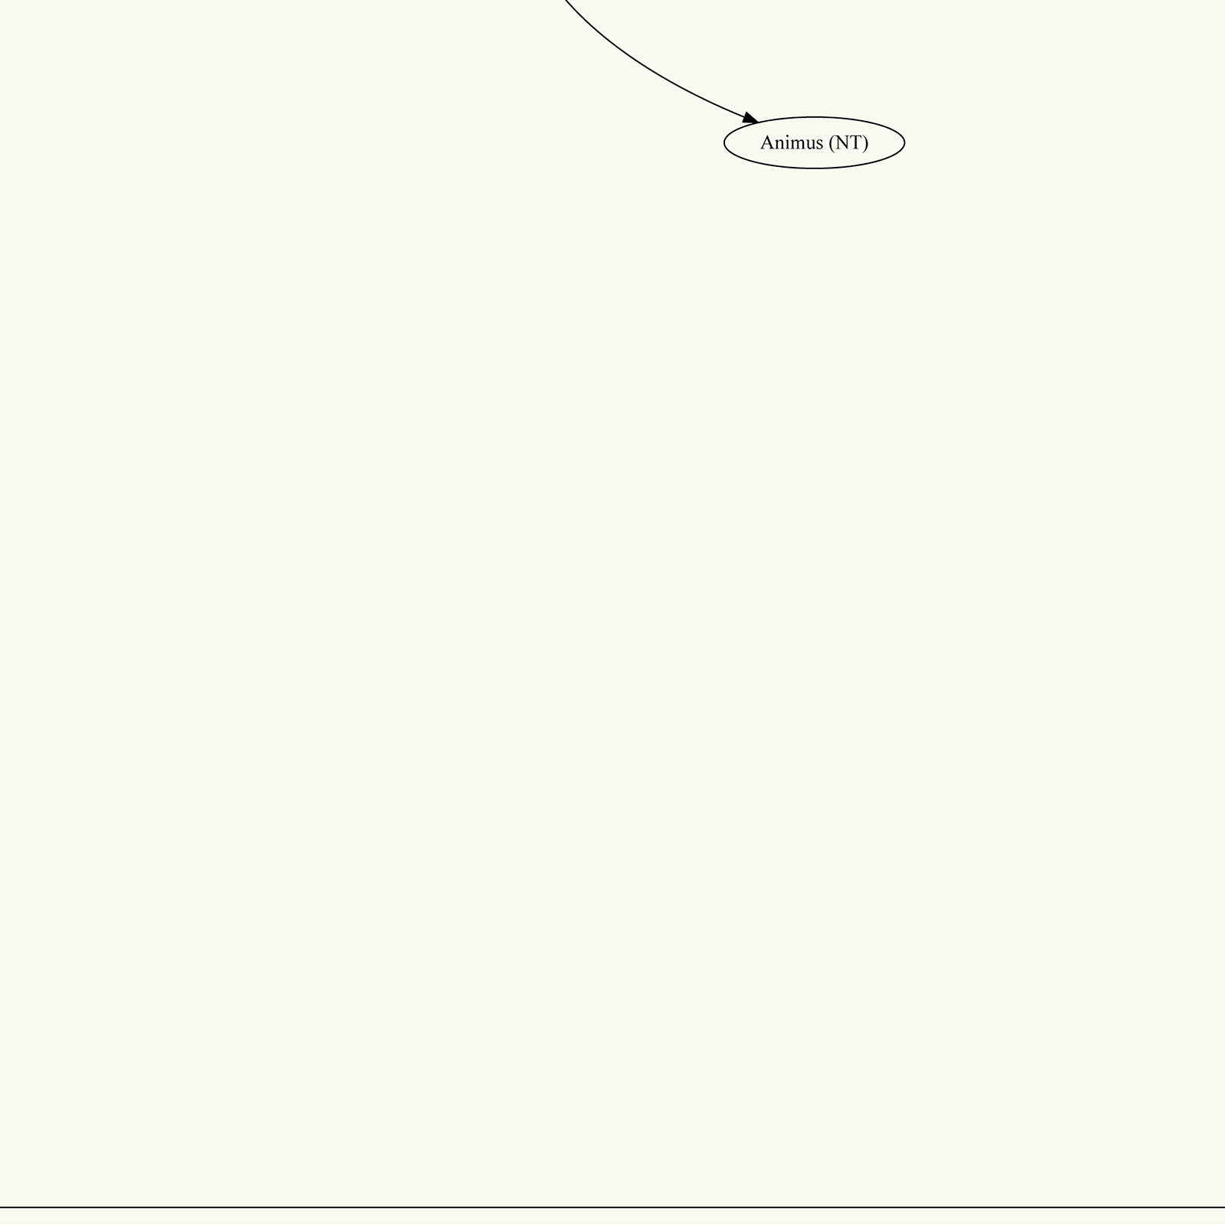
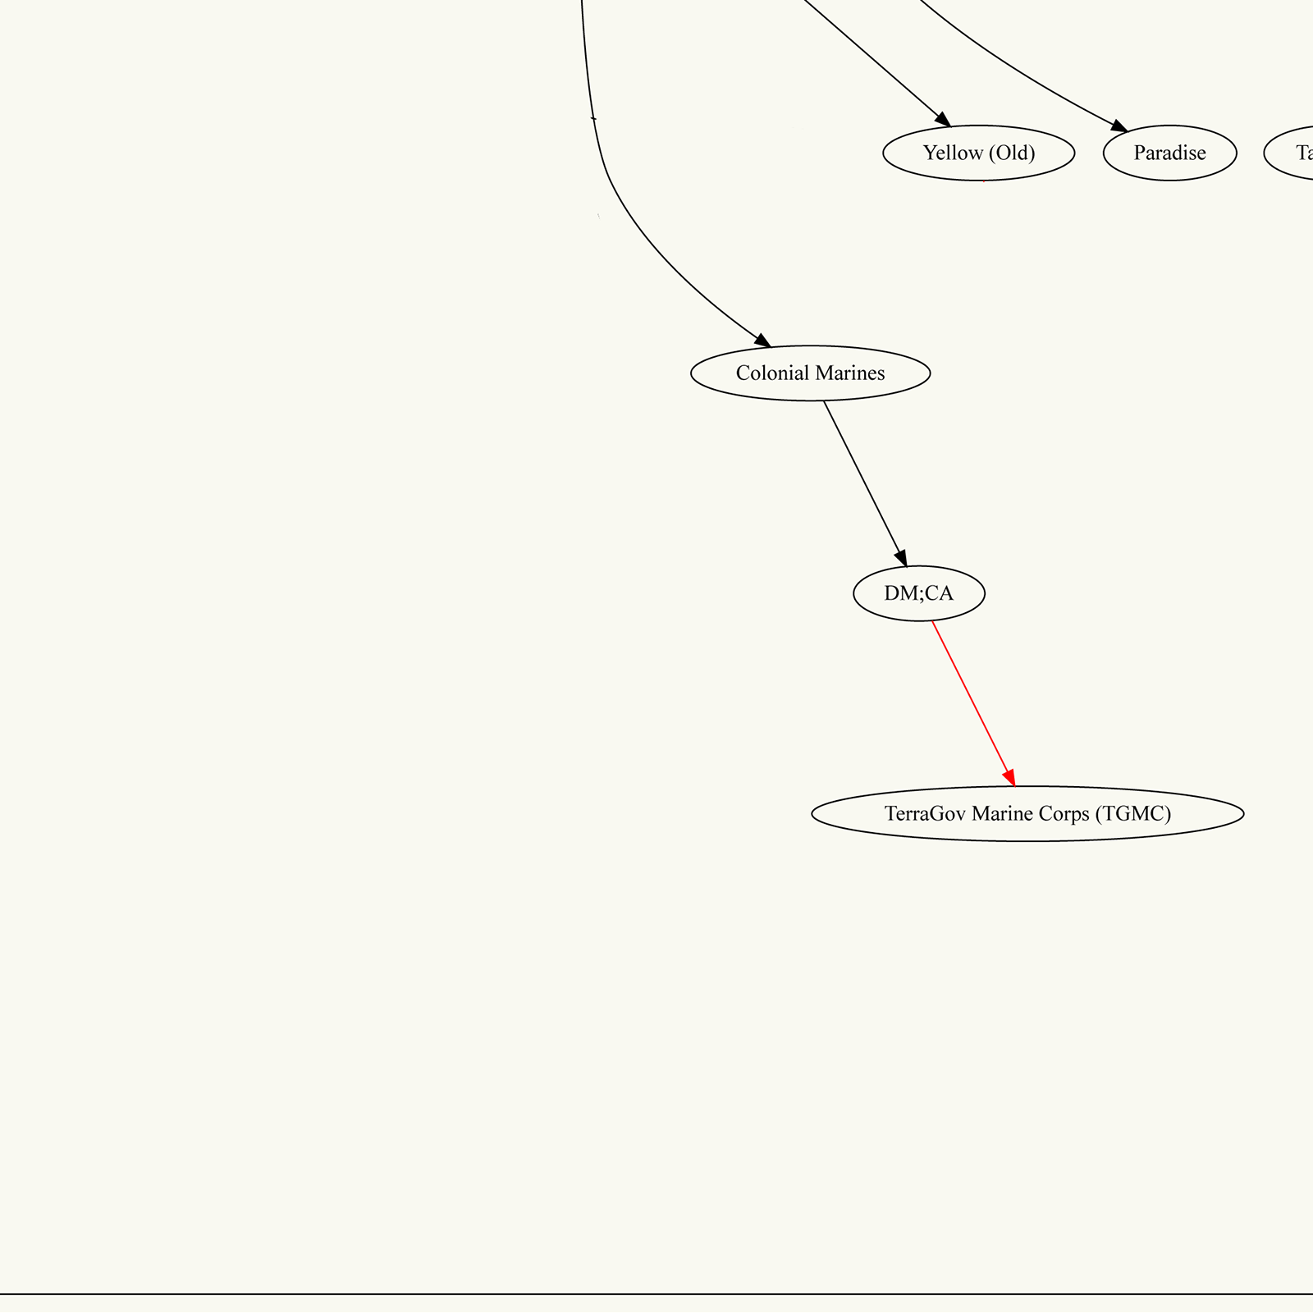
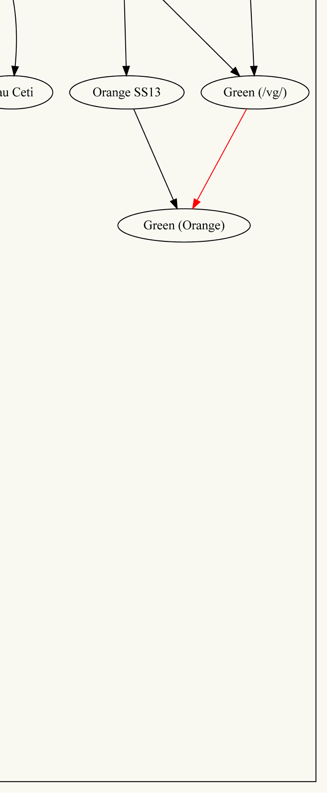
More forks…
Notes:
There were more forks…

Slide 7
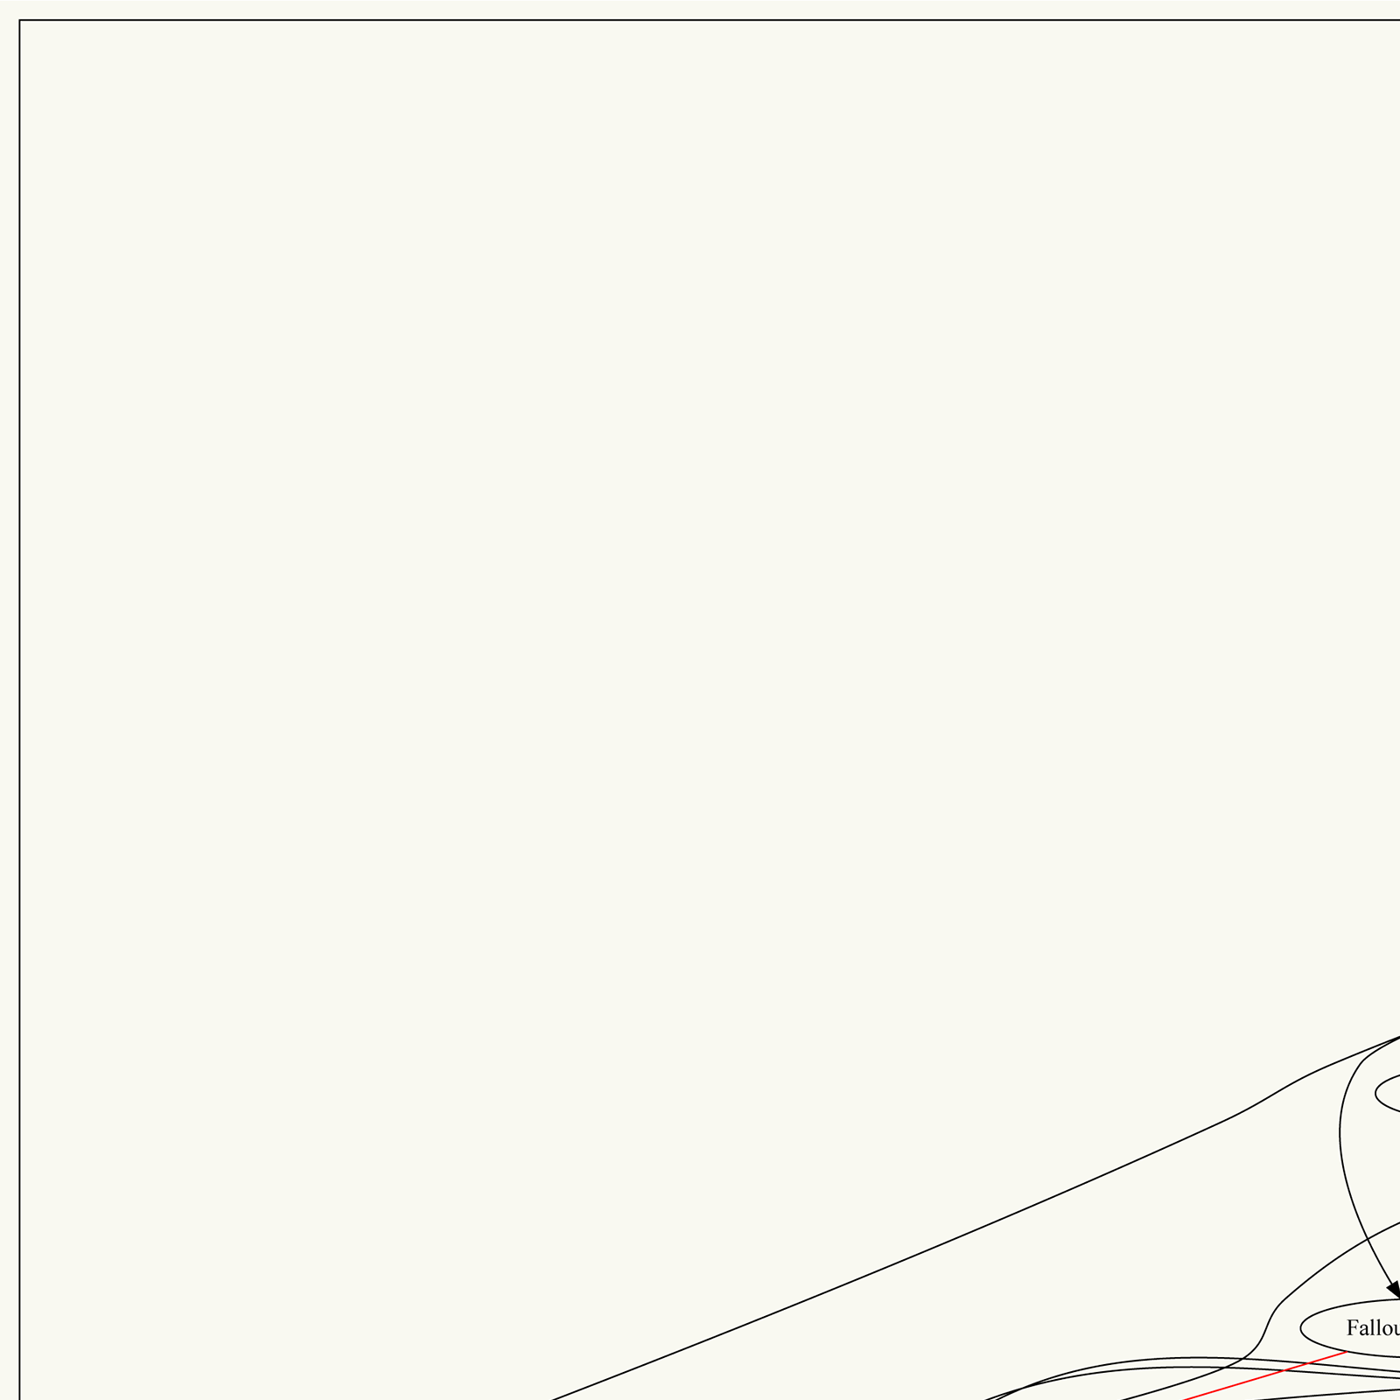
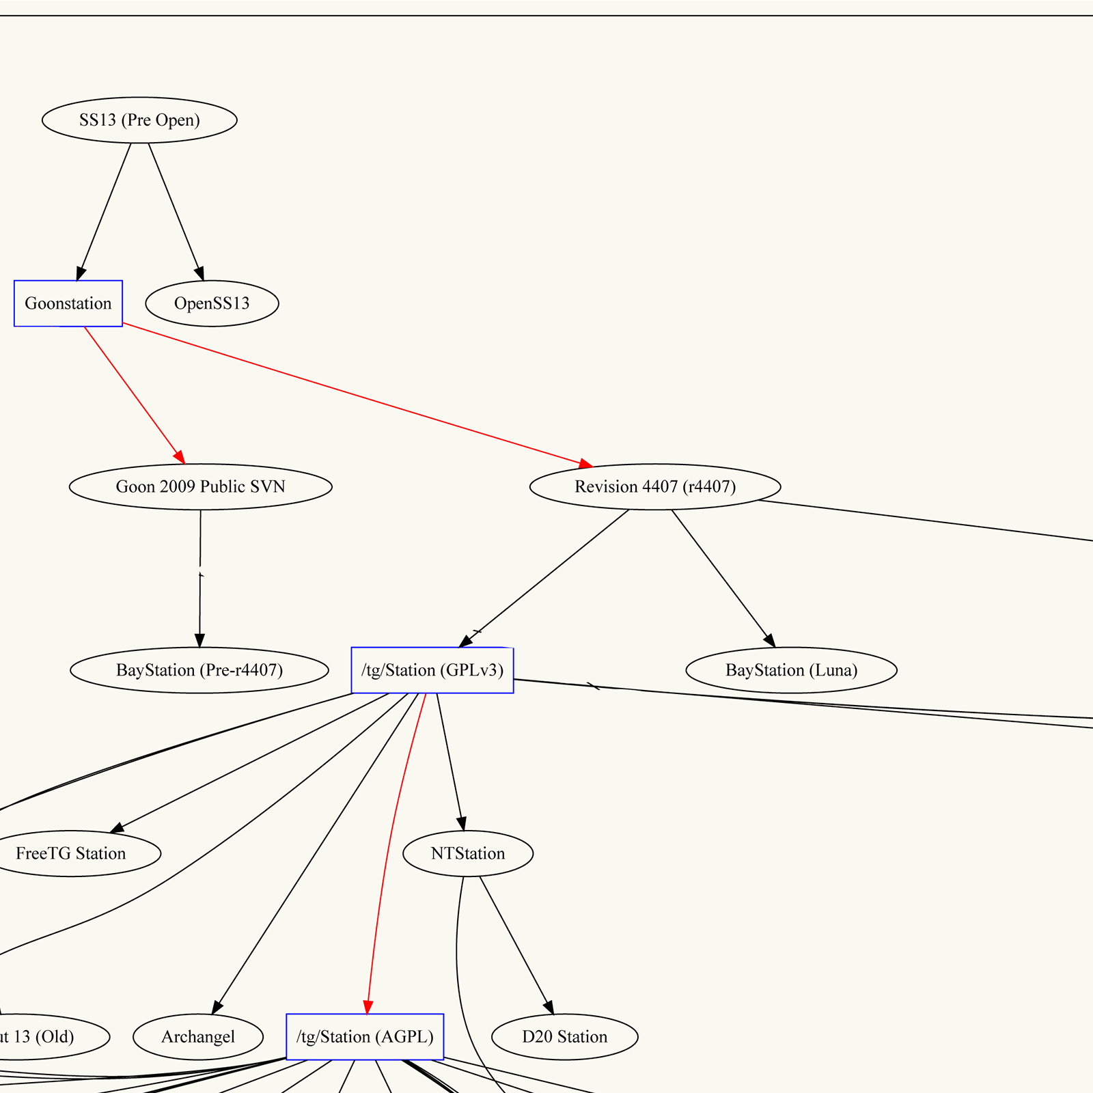
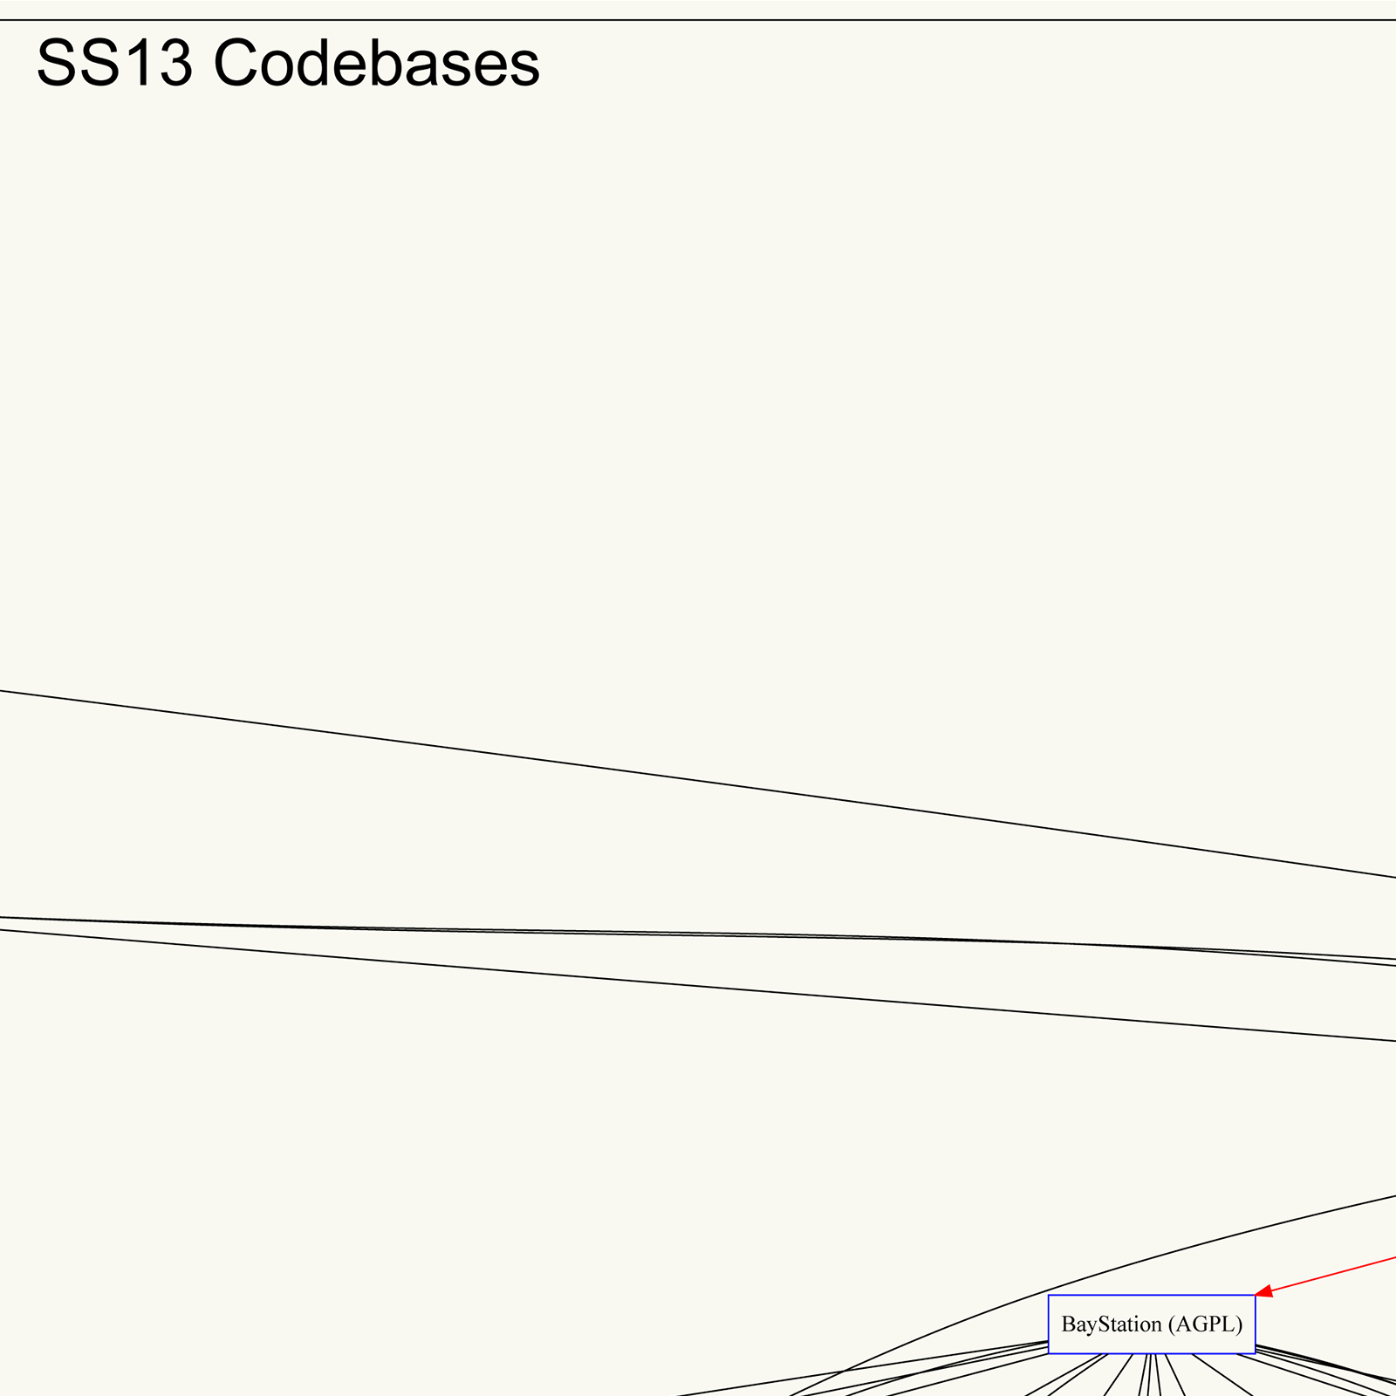
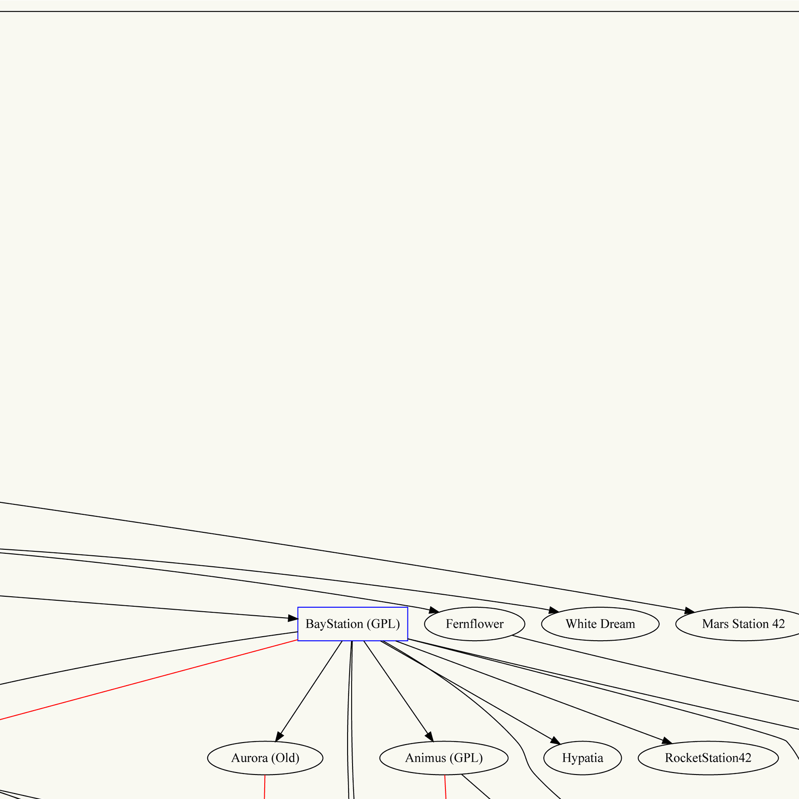
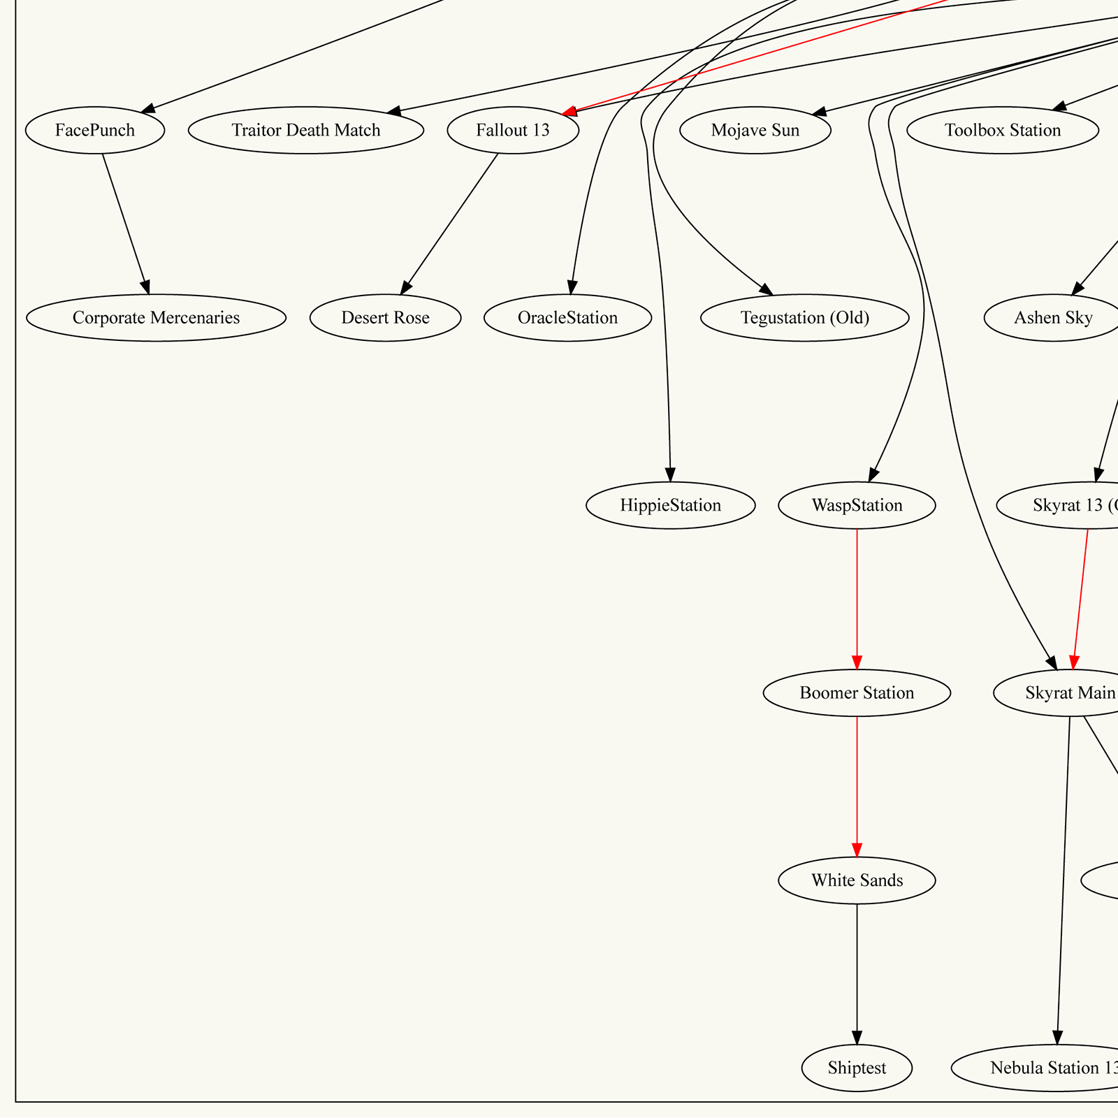
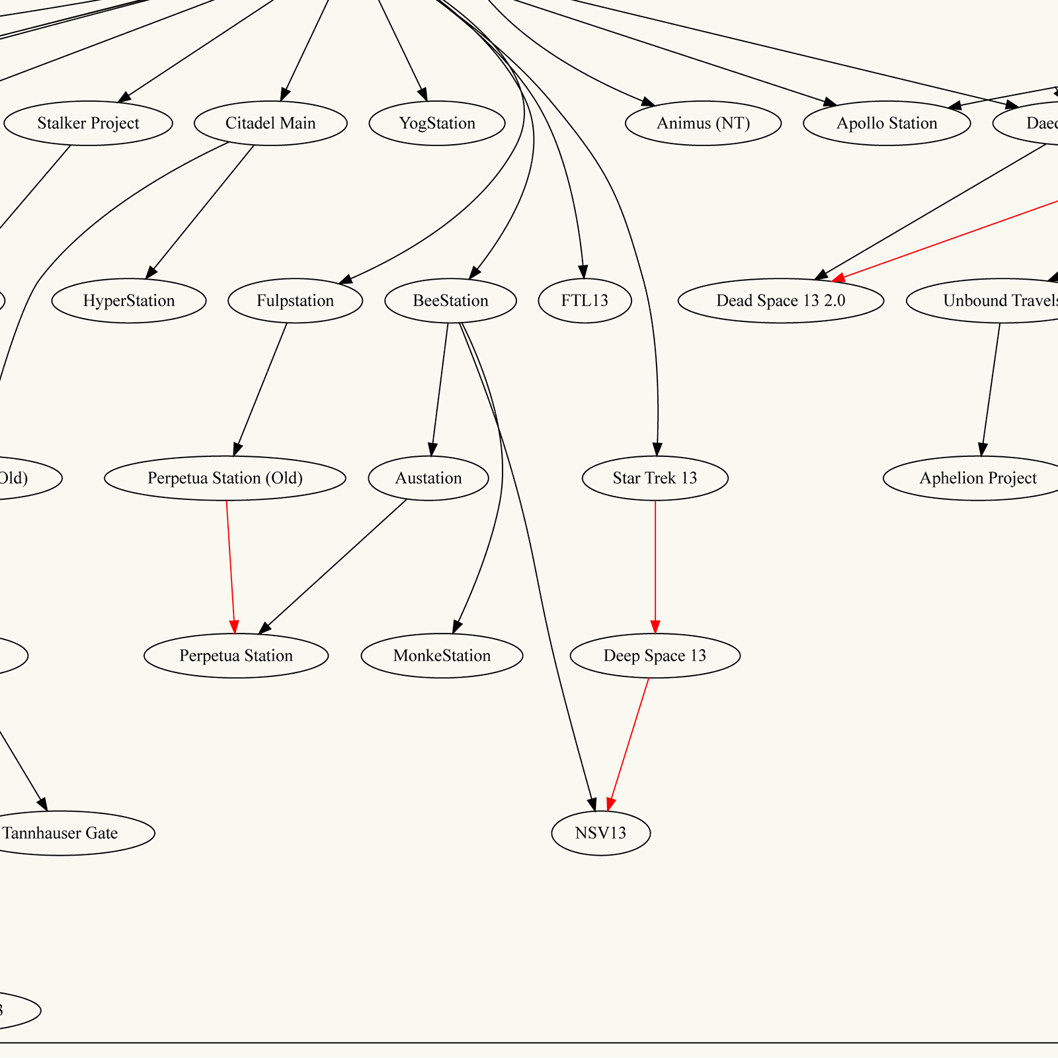
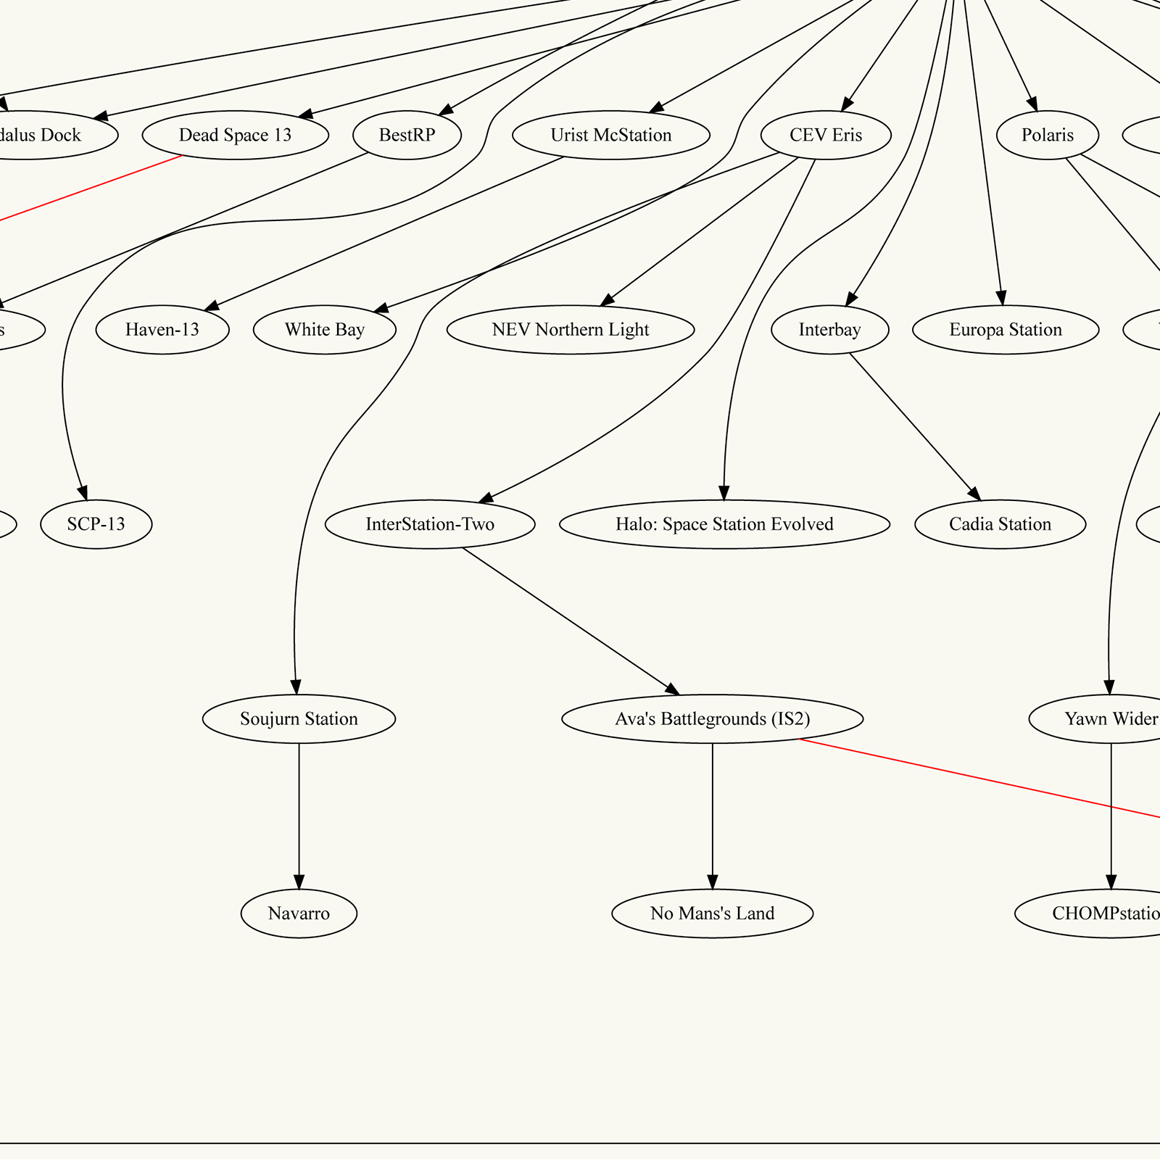
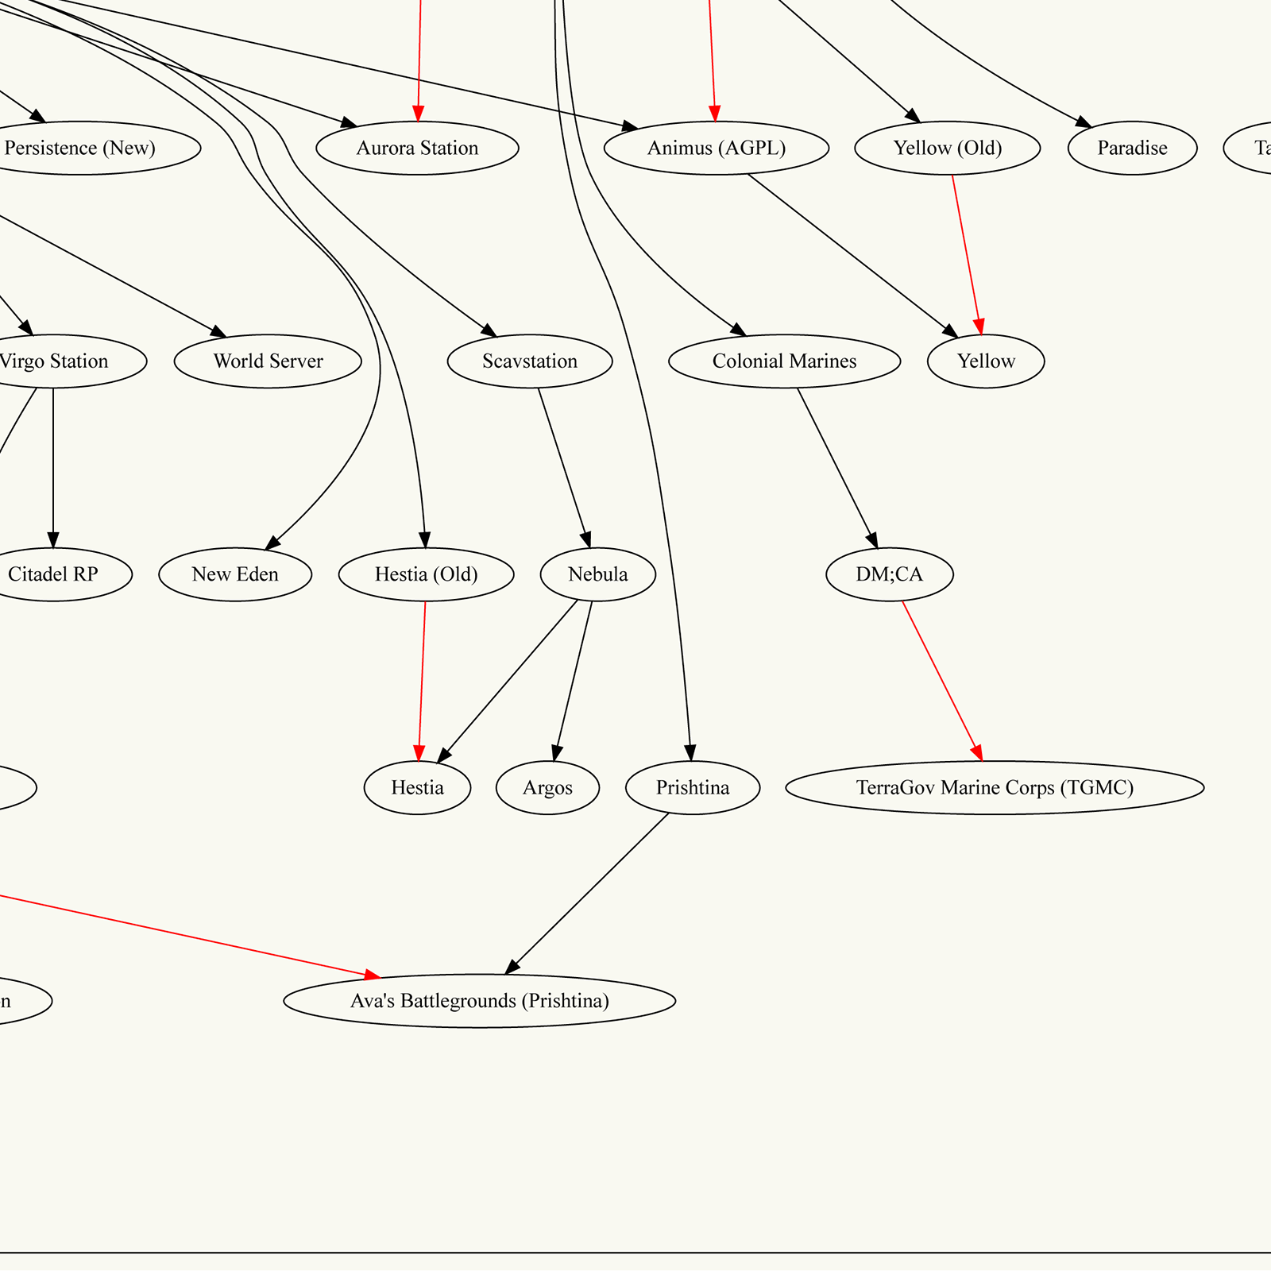
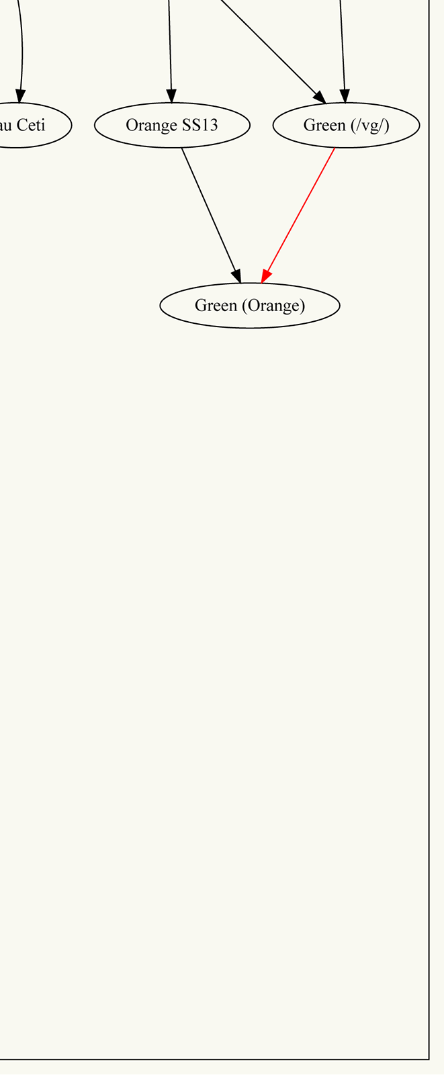
That’s a lot of forks…
Notes:
…and even more. This is actually a pretty cut-down version of the family tree.

Slide 8
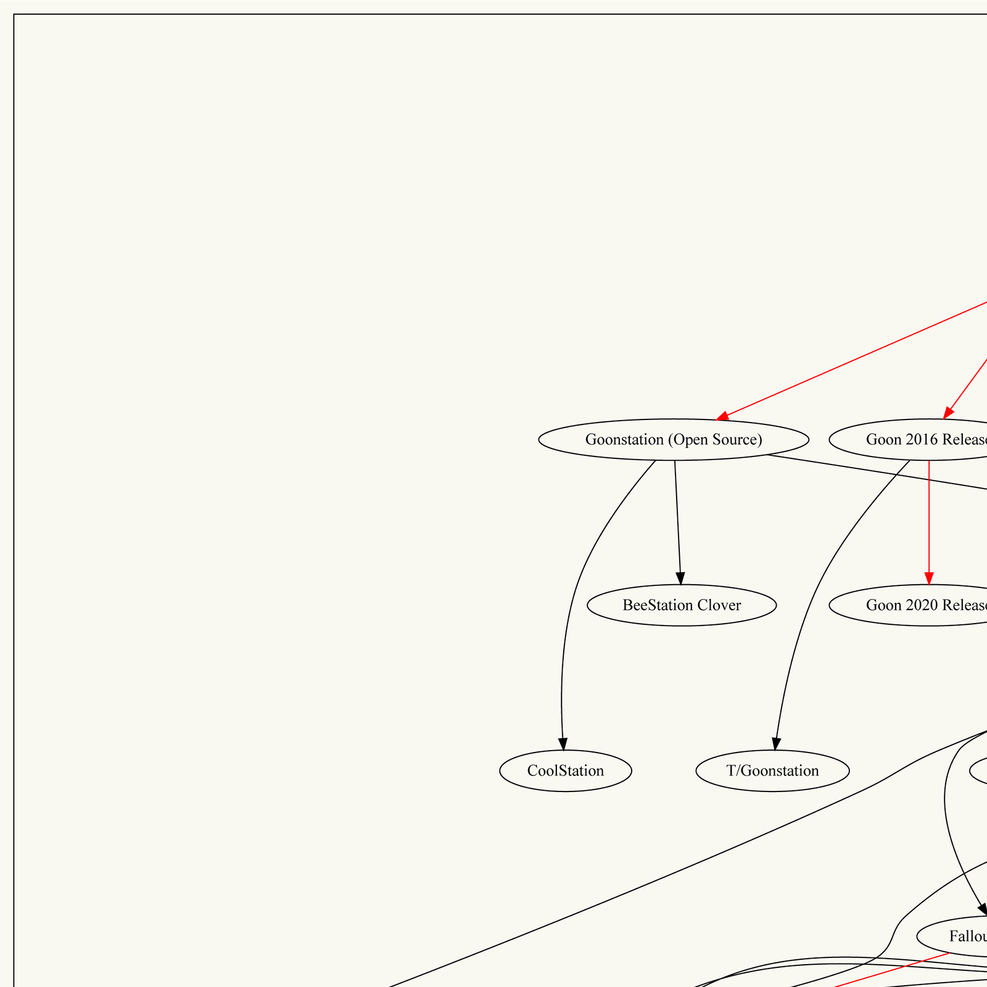
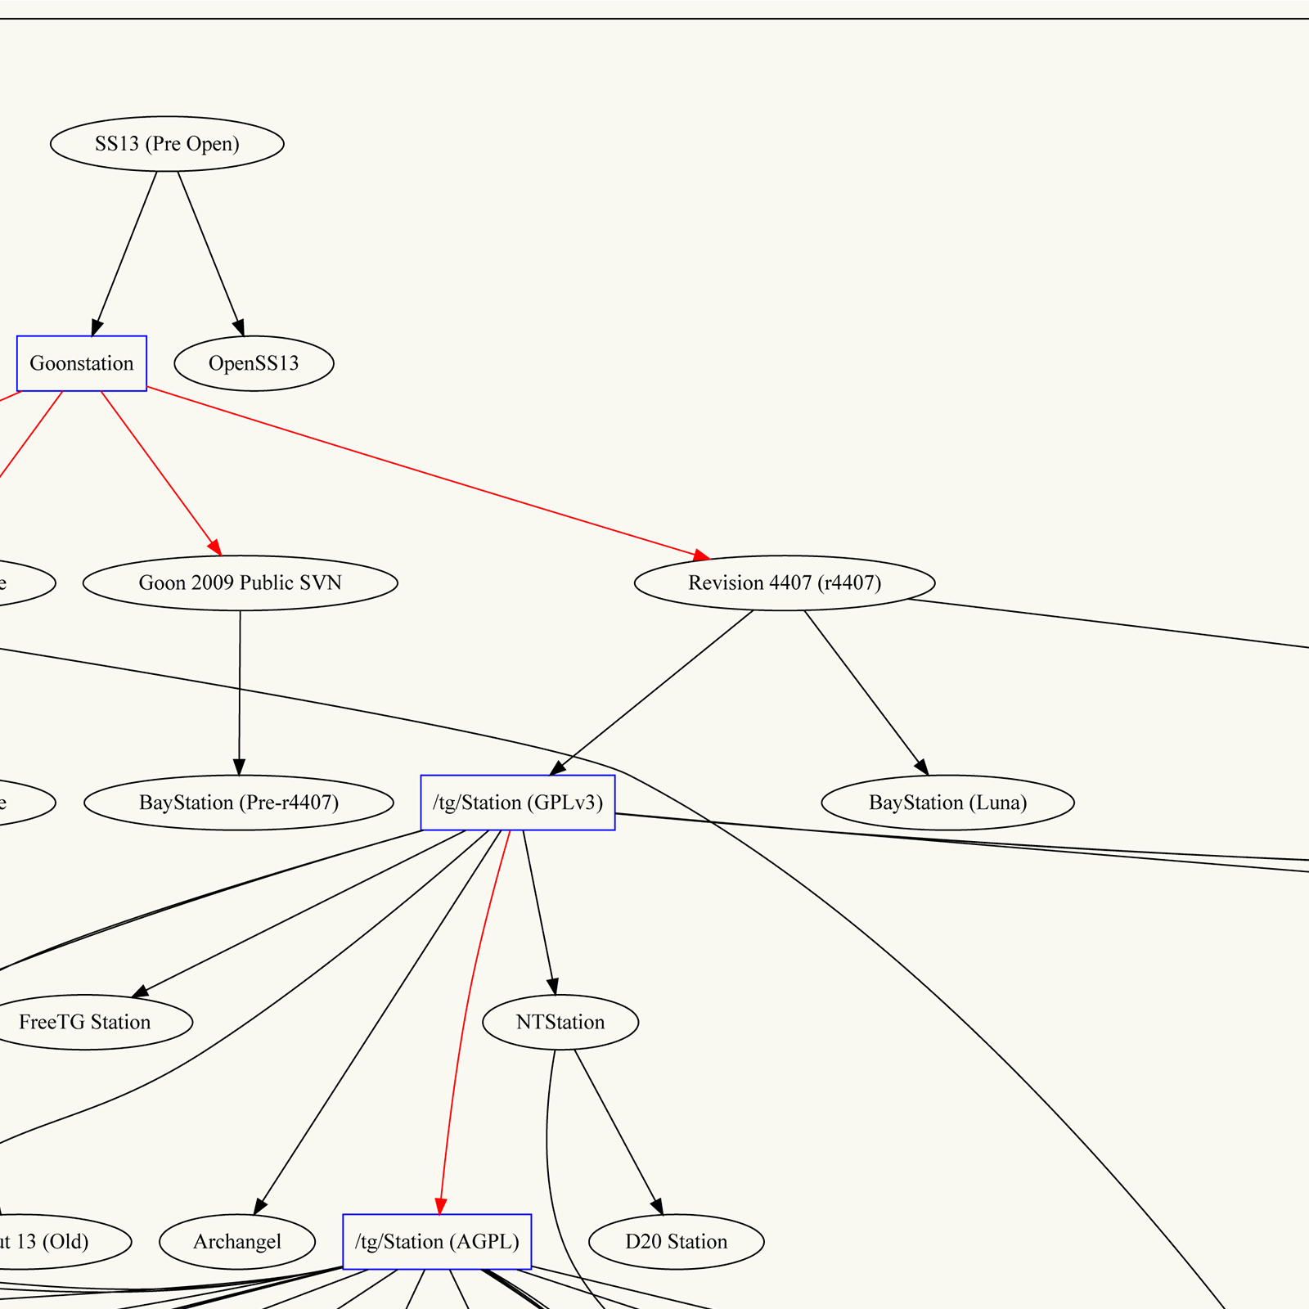

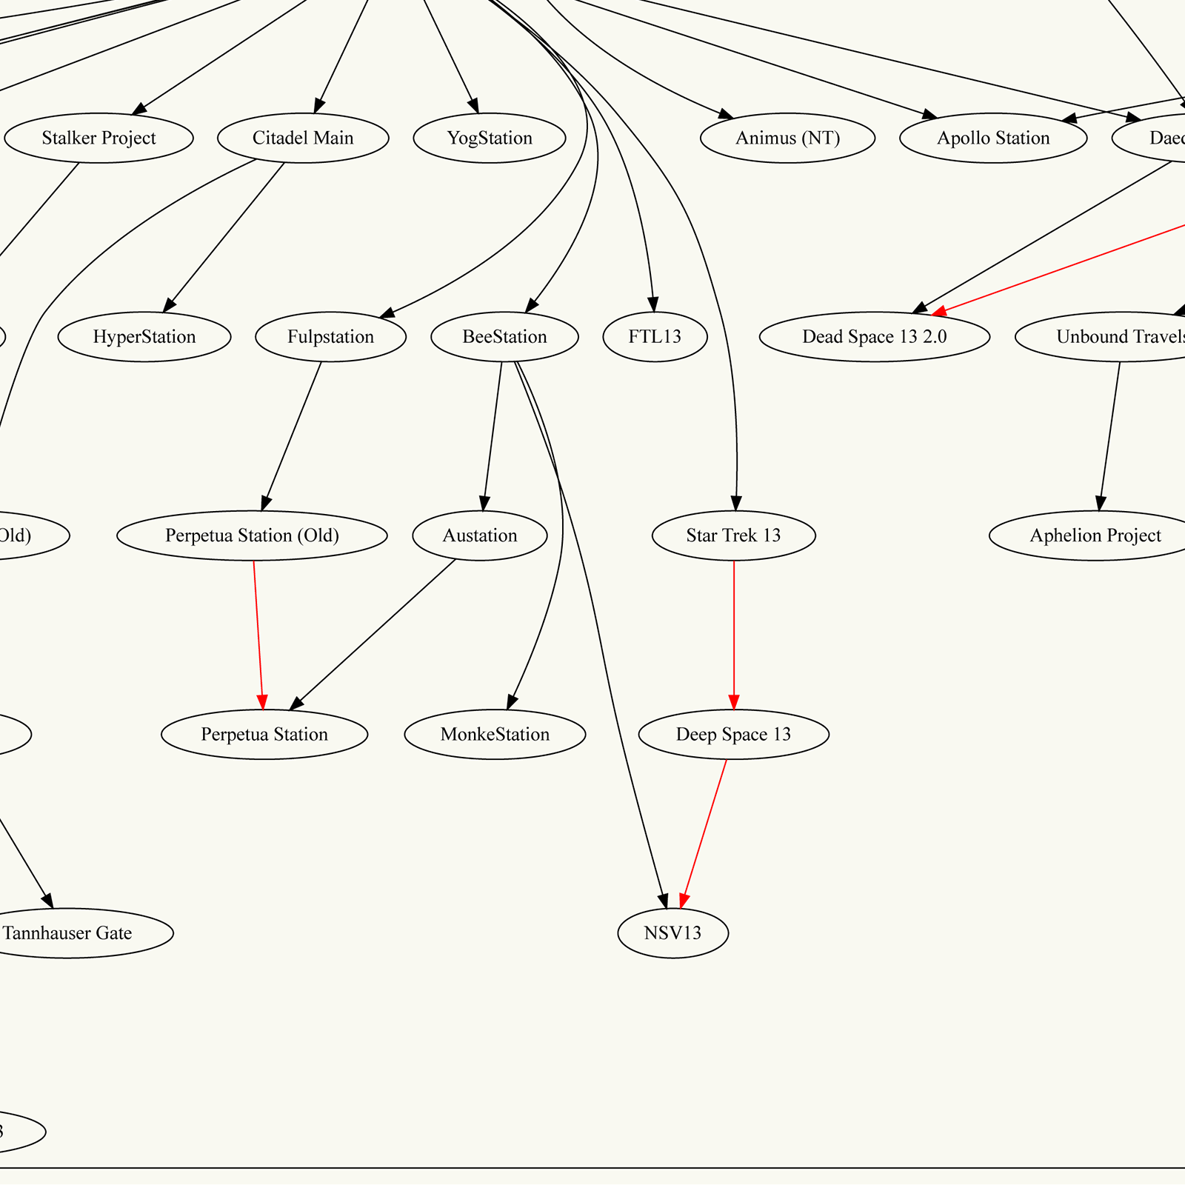
SS13 Today
Notes:
Over here in the blue [*points to oss] brings us to 2020 - going open source.

Slide 9
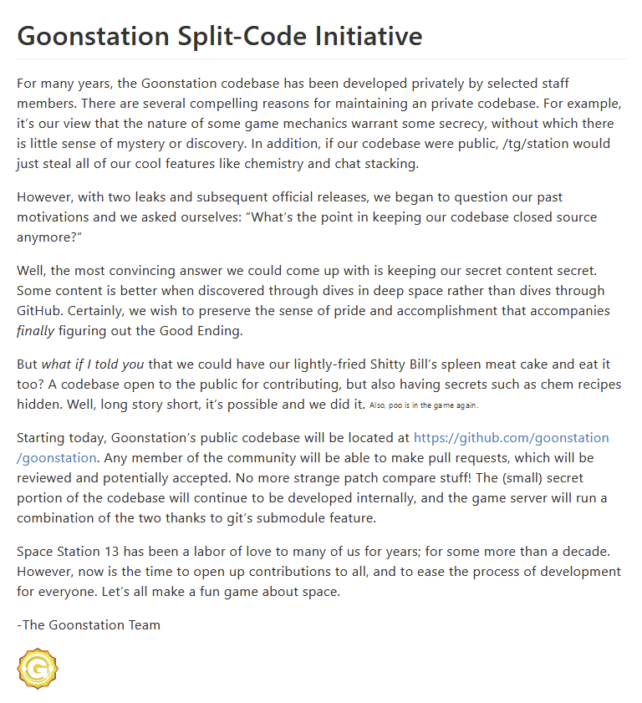

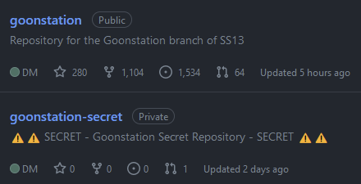
Open Source
Small (~3%) secret submodule
  Server-Side Extension?
April 1st, 2020
Notes:
After being closed source for 11 years, we open-sourced our code on April 1st, 2020 - we thought it’d be a bit funny.
Most people thought it was a joke, until the next day when the codebase was still there. But, it took a lot of work to get to the current contribution experience.
And here’s the caveat of the talk: The Official Goonstation servers aren’t 100% open source, depending on how you measure it.
We currently have maintained a small (1-4%) secret git submodule for mainly a few things: mysterious one-off storytelling events, some code for ban evasion detection, and gimmick features for gameserver admins.
You could consider it a server-side extension to the official game servers, or not.

Slide 10
Open Source
Small (~3%) secret submodule
  Server-Side Extension?
Otherwise fully open-source
  Website
  API & CI/CD
  Bots
April 1st, 2020
Notes:
However, the extreme majority of our code, and just about everything we do is open-source, so we generally brand ourselves as such.
For example, our website, API and CI/CD, and bots - all open source.
So, what are the sorts of things we had to do to get where we are, transitioning to open source without a real prior contribution community?

Slide 11
Initial Decisions
℗
Notes:
As with any organization going under a big change, there’s major initial decisions you have to make. I’ll be going over the main things that are necessary for every project.
Also, for the rest of this talk, I’ll be this little P symbol to indicate if a software or service is proprietary.

Slide 12


Licensing
More permissive (MIT)
More copyleft (AGPL)
For us, CC-BY-NC-SA
  Not really for code…
  Inherited
Notes:
The first of these is what license you’re going to put the project under.
This can range from something very permissive like MIT, to something more restrictive but copyleft like AGPL.
For us, our licensing situation is slightly funny. Basically everything in the project is licensed under CC–BY-NC-SA. Or, Creative Commons Attribution Non-Commercial Share-Alike.
If you've worked with licenses before, this might sound a /bit funny/.
This family of licenses are mainly meant to license assets like sprites, not code. We had the disadvantage of being around for 11 years before open-sourcing, so we inherited this interesting license choice.

Slide 13

Licensing
More permissive (MIT)
More copyleft (AGPL)
For us, CC-BY-NC-SA
  Not really for code…
  Inherited
A complex decision
Notes:
As for choosing a license for your own project - you might be in a similar inherited situation, or you might be in the much more ‘fun’ boat of having to choose.
This could be a whole talk by itself, and I’m no copyright lawyer, but the basics of the choice is to consider how you want the community to operate.
If you want all of the game (as well as eventual forks) to remain open-source, then maybe something like AGPL could be up your alley.
Or, if you want to be able to make secret content, you might need something more lax. It also depends on your method of actually distributing the game.

Slide 14
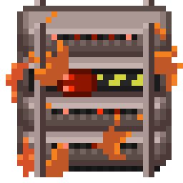

Costs
Servers cost money
Notes:
For example, we run servers hosting our codebase. As we are a completely free game, we don't charge users to play.
However, running all of our server infrastructure and related back end does cost money.

Slide 15

Costs
Soliciting donations from community
Various platforms:
  Patreon℗
  GitHub Sponsors℗
  Ko-Fi℗
  All proprietary…
Servers cost money
Notes:
We pay this by soliciting donations from generous community members to help pay for costs - however in the past it was out of pocket.
We personally accept donations on platforms such as Patreon and GitHub sponsors.
There's also other great services like ko-fi which don't have fees. That’s especially useful if you’re a small project where every cent pays the bills.
But, all of these services are proprietary - there’s some open-source solutions but you’ll eventually have to go through some payment provider.

Slide 16



Distribution
Where’s the source?
  Accessibility
SS13 is on GitHub℗
  Greater community & forks
GitLab / self-hosted git
Notes:
You also want to think about where you're going to be distributing the source for your game.
Ideally, it'd be in a format that people are already familiar with to lower the contribution barrier.
We personally use GitHub as that is where the larger space station 13 community resides,
however you could also replace this with a service like GitLab or host it yourself.

Slide 17


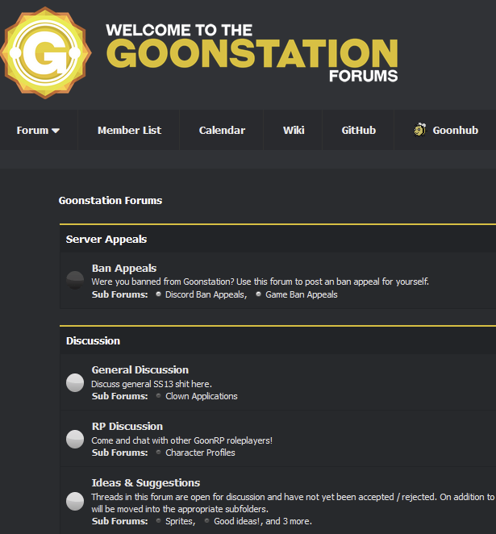
Communication
Chatting vs long-form discussion
Primarily use Discord℗ and a forum (MyBB)
  Revolt?
GitHub℗ Discussions?
Notes:
You’ll need to choose a platform for communication, so it’s important to be aware of the different types of community platforms.
For example, one tailored towards chatting like IRC, or one for long discussions like a forum.
In our case, right now we primarily use Discord for communicating and planning and we have a forum set up for ideas and suggestions.
However, Discord is not open source, but you could replace it with a similar program like Revolt or IRC.
However, plenty of open-source communities purely communicate on their code platforms like GitHub or elsewhere - it’s really whatever you think is best for your community.

Slide 18
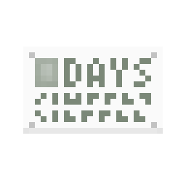
Initial Steps Recap
Licensing
Costs
Distribution
Communication
Notes:
So, when starting off with a new open-source project, you’ll need to consider:
Licensing,
Costs,
Distribution
and Communication
before really building a community.

Slide 19
Contributor Experience
Notes:
Now, after going open source, the next thing we tackled was the experience of each contributor.

Slide 20

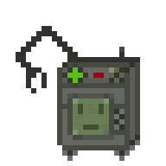
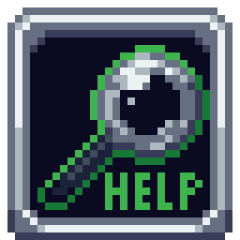
First Time User Experience
Initial onboarding is critical
Streamlined and easy to follow
All skill levels
Notes:
The most important thing we found is that the initial onboarding process for contributors is crucial -
if it gets to be too much at once, potential contributors can get discouraged from contributing.
Having it streamlined and easy to follow makes it easier for anyone,
even people who have never coded, made a sprite, or worked on a game at all before.

Slide 21
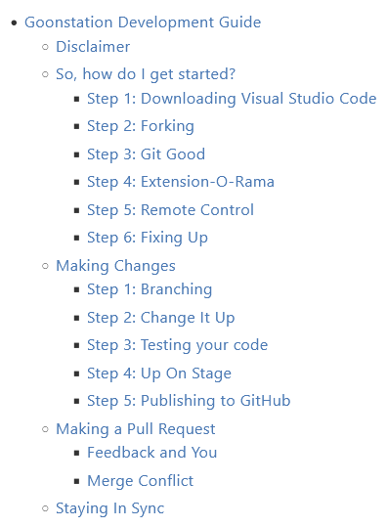
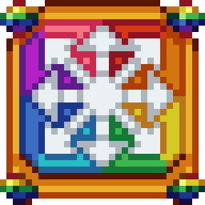
In-Depth Onboarding Guide
Singular point of entry
Basic workflow
Simple & advanced topics
Guides within
Notes:
One way we’ve tried to improve the first-time onboarding experience is having a singular point of entry: our Development Guide.
It covers the whole basic workflow, from downloading git, to editing code and sprites, and then making a pull request.
We aim to have both simple and advanced topics covered.
For example, we have in-depth guides on how to use a debugger or fix merge conflicts.

Slide 22
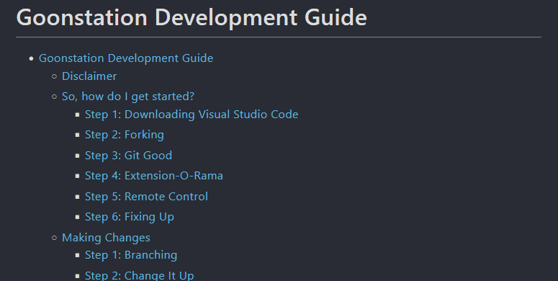
In-Depth Onboarding Guide
Notes:
So, it’s a big long markdown document that goes through everything - as you can see.

Slide 23
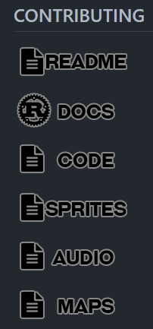





Clear Contributing Guidelines
Guidelines for everything!
  Code
  Sprites
  Audio
  More!
Notes:
Another thing we’ve found to be important for the quality of our game is to have easily-referenceable guidelines for each asset type.
This means we have guidelines on
basic code formatting,
what sprites should look like,
the qualities of audio we want, and more.

Slide 24
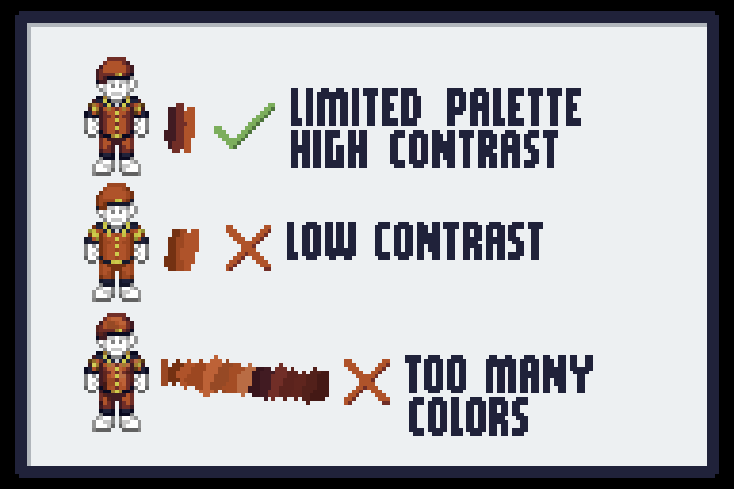
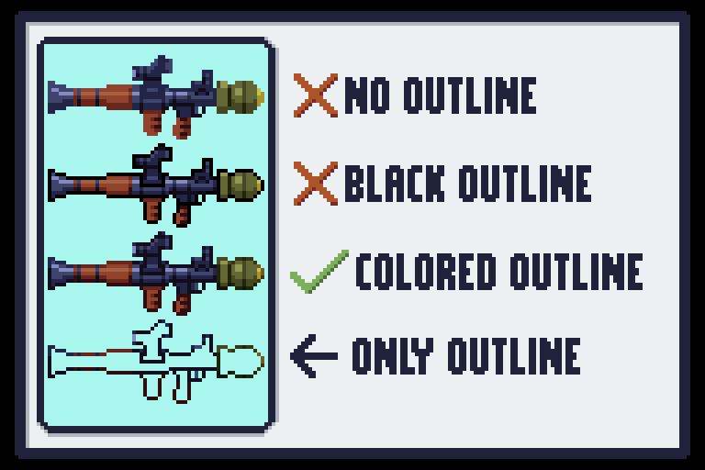
Clear Contributing Guidelines
Notes:
For example, here are some of the graphics from our spriting guide. Most of the guides are just a lot of text, though.

Slide 25
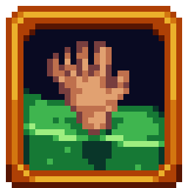
Digestible Onboarding
Intentionally lower the bar
  ‘Monthly’ contests
Small yet visible contributions
  Small map piece
Empowers non-traditional contributors
Notes:
Finally, we’ve tried to intentionally create areas where the bar to contributing is as low as possible.
Every few months (we tried to do monthly but it’s a lot of work) we hold a small contest to contribute small pieces of content.
For example, a very small 3x5 room used in procedural generation or the ingredients in a wacky soda from a vending machine.
I believe these small contributions let non-traditional contributors make their mark on the game, and demonstrate how easy it can be to contribute anything at all.

Slide 26


Controversial Changes
Disagreements
  Balance Changes
  Removals
  Not Merging
Inevitable
Transparent decision-making & communication
Notes:
Eventually, players/contributors will disagree with maintainer decisions.
These often will be things like balance changes, removal of features, or simply not merging something.
This is fairly inevitable, as not everyone agrees on everything!
However, it's important to handle these decisions transparently.

Slide 27


Town Halls
Town Halls as Q&A
Hasn’t really worked
  Too much time
  Duplicate questions
Asynchronous?
  Still lots of time…
Not the worst
Notes:
For example, a popular way for development teams to get feedback from players has been through the use of frequent town halls, operating as q&a sessions.
But, honestly, it hasn’t really worked out for us.
We’ve found that they put a lot of burden on our volunteer team, as a handful of people need to spend potentially hours answering duplicate questions.
We’ve also tried an asynchronous version where players could submit their questions ahead of time but that still took hours to craft answers to each and every question.
However, they’re definitely not the worst, and can be a valuable tool depending on the size of the community.

Slide 28

Communication
Clarity on how the team feels
Continuous feedback
Notes:
Another way to potentially head off players being disappointed about changes not making it in is to be clear about expectations, how maintainers will communicate how they feel about projects.
One way we've found to help with this is to give continuous feedback on proposed features.

Slide 29
#Player-Projects
Forum
Notes:
We use Discord Forums for this, but this can be implemented using traditional forum software as well (we just wanted to consolidate).
Essentially, we have a subforum…

Slide 30

#Player-Projects
Project Threads
Official project venue
Advertising & feedback
Forum
Notes:
Essentially, we have a subforum… where contributors can create threads about their projects.
[Image]
This also acts as an official venue for contributors to advertise their projects and perhaps attract co-contributors.

Slide 31



Player Project Difficulties
Problem: Idea dumping ground
Solution: Design Documents
Notes:
However, this idea took some work to become especially useful to us.
At first, the venue was being used as a dumping ground for ideas - which while they might be interesting, there was just nobody working on them, which wasn’t really the point of the space.
Our solution was to impose some small restrictions like having to have a somewhat fleshed-out design document, so people need to commit at least a little bit to an idea.

Slide 32

Design Document
Notes:
For the design document template, there’s a few main sections.
The first, the abstract, is a few sentences to introduce people to the idea.
Then we have goals and non-goals: things you want, and don’t want.
The content section is all about the actual implementation, whereas the alternatives section concerns other ideas you thought about.
The final and most important section is about what potential changes you could foresee happening if people disagree with parts of your idea.

Slide 33



Success!
Maintainer-Sponsored: Fishing
Multiple Contributors: New Gamemode
Single* Contributor: New Map
Notes:
So, here are some examples of projects that have gone through this process.
We’ve had a map added that is mainly worked on and maintained by a single contributor.
We’ve had multiple contributors come together to make a whole gamemode, reworking so much foundational code in the process.
Right now, we have a fishing expansion that is being sponsored and shepherded by a maintainer.

Slide 34



Agreement
Some changes are incompatible
  Something else entirely
Open-source: fork
Other novel usages
Notes:
At the end of the day though, some changes are just fundamentally incompatible.
There might just be a difference in design philosophy, or they want the game to be something else entirely
This is part of the beauty of open-source - anyone can start a fork.
For example, people have used our codebase as a persistent storytelling platform, and more.

Slide 35

Contributor Recap
New contributors:
  In-depth onboarding guide
  Clear contributing guidelines
  Digestible onboarding ideas
Controversial changes:
  Town Halls?
  #Player-Projects
    Design Documents
Notes:
So, when getting new contributors to your project, you want it to be:
As Easy as possible to onboard,
Clear submission guidelines,
And have easy projects already prepared.
When dealing with controversy,
You want to get everyone’s input whether that’s in the form of town halls,
Or perhaps shifting left and giving feedback on ideas rather than implementations.

Slide 36
Maintainer Experience
Notes:
Now that we’ve covered how we smoothed out the contributor experience, I want to talk a little bit about how we've lessened the work maintainers need to do, reducing overhead.

Slide 37

Combating Burnout
Completely Free
  All volunteer
People do what they want
  ‘When you code it’
Critical: don’t overextend
Notes:
This being a completely free game, we don't really have funds to pay contributors with - while we do cover server costs with donations, we don't pay ourselves.
So, we can't really expect nearly the amount of work someone would expect from an actual employee of a company - everything's on a purely volunteer basis.
If nobody wants to do anything it just doesn't get done. This has even resulted in a saying, ‘when you code it’.
So, it’s important to focus on how to prevent contributors from burning themselves out and overextending themselves.

Slide 38



Feature Freezes
No new features
Address issue backlog
Large refactors
Take a break
Notes:
Feature freezes are opportunities for a lot of things.
For those unfamiliar with the term, essentially that means for some period of time (we normally do a month), new features aren’t added to the game.
Traditionally this allows contributors to focus on fixing backlogs of bugs that might not otherwise get addressed.
However we also use them as opportunities to work on large-scale refactors that would disrupt the normal flow of PRs immensely.
And finally it's an opportunity to take a break and prevent burnout.
For example, we usually have one during December because everyone is off for holidays and spending time with family anyways.

Slide 39


Backlog
Timely Reviewing
  Difficult
Enlist community
Notes:
And so as far as merging and reviewing PRs on a timely basis, it can definitely be difficult with an all-volunteer team.
People’s lives just get busy.
One way to help speed up this process is to let the larger community help out in small but significant ways.

Slide 40


Triage
℗
Easy to join
Label PRs & issues
Request reviews
℗
Simple form
  Low barrier
Notes:
One such way is by having an extremely easy-to-join ‘triage team.’
On the GitHub platform, members with triage permissions can do basic tasks like labeling pull requests and issues,
requesting reviews, and more.
We set up a simple form that just asks for their game and GitHub username, and that’s it.
By keeping the barrier low, we enable more people to help out.

Slide 41




Organization
Area
Category
Status
Area
Category
Area
Notes:
With a triage team, it’s also important to have labels that matter.
In our case, we have 3 main types of labels for our issues and pull requests: Areas, Categories, and Status. Kudos to Bevy for this system.
The Area defines the part of the game it impacts, like the medical system vs an AI change.
Categories explain if it’s a bug, a rework PR, a new feature, etc.
Status is used to mark PRs that have a merge conflict, open for adoption to another contributor, and more.

Slide 42
Organization
Area
Category
Status
‘S-Ready-For-Final-Review’
  Community Reviews
Notes:
One such tag that helps decrease the maintainer workload is the ‘Ready for Final Review’ status tag.
A maintainer or triage member can put that label on a PR to indicate that it’s been reviewed by a few people and just needs one more look over.
This is one of the ways we help encourage people of any skill level to help out and do community reviews.

Slide 43

Maintainer Recap
Burnout
  Feature Freezes (breaks)
Enlist the community!
  Triage Team
  Community Review
Notes:
So, to recap:
To help with maintainer burnout, it’s important to not overextend yourselves and take breaks.
By enlisting the greater community to help, whether that be labeling issues or engaging in community review, there’s less work for everyone involved.

Slide 44


Closing Thoughts
A challenge
  But achievable!
Try out community ideas!
Open-source rocks!
Notes:
It was definitely a challenge to get to our current contributor experience, but definitely achievable after lots of work from the community and the team.
By trying out ideas from the community, you can help make it a better place for everyone.
We’re really glad we moved to open-source - we’ve had so many great collaborations happen as a result.

Slide 45

Acknowledgements
Team & Community!
For more:
Alice Cecile: Your Open Source Repo Needs A Project Manager @ RustConf
Pepper Riemer: Space Station 13: Behind one of the Largest Open Source Games @ GDC
Notes:
I would definitely like to thank my amazing team and the community for this wonderful journey into the world of open-source.
If you're looking for more thoughts on this subject, I highly recommend checking out Alice’s talk from RustConf, or my fellow developer Pepper’s talk given at GDC last year.

Slide 46

Image Attributions
Sprites by Goonstation Contributors / CC-BY-NC-SA 3.0
Twemoji by Twitter / CC-BY 4.0
Notes:
Here’s some attributions for the images in this talk…

Slide 47
Thanks!
℗
github.com/Kai-Richardson/fossy23
Notes:
That’s it, thanks! The slide deck and everything can be found on my GitHub.
I think we have time for a quick Q&A if there's any questions?

